Slide 2
You can’t judge a book by its cover (or can you?)

Slide 3
Outcomes
analyse a book of your choice from the Bookworms collection
summarize information from the chosen book
determine criteria for delivering a successful presentation
present the chosen book following the guidelines in the task
assess the presentations of peers

Slide 4
Before reading (in class)
WARM-UP
Label the book cover with words from the box.

Slide 5
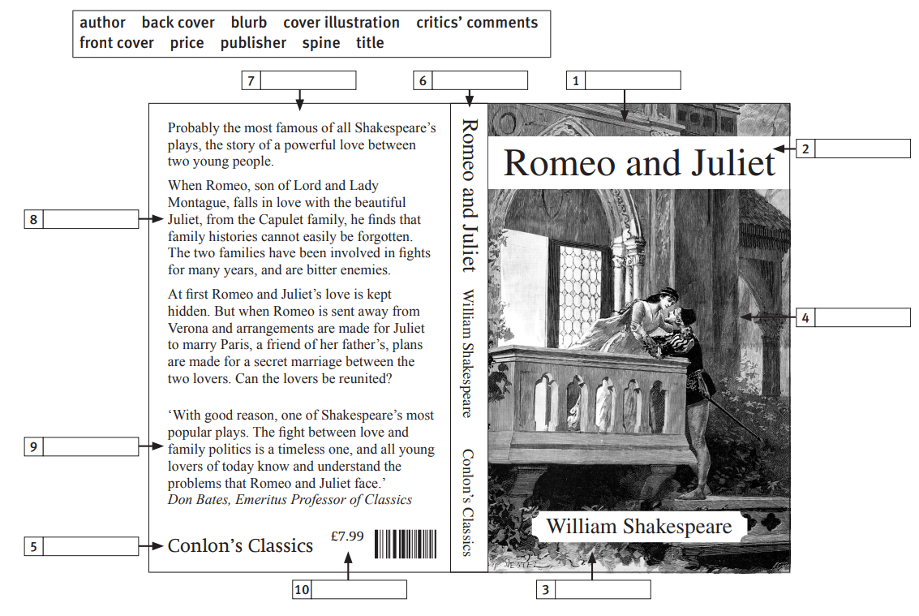
Book cover
Notes:
Source: Oxford Teachers’ Club at http://bit.ly/3GVslnk

Slide 6
Think-Pair-Share
Students discuss the questions.
What was the last book you read?
What was it about?
Did you enjoy it? Why?/Why not?
Do you think reading books in English might be a good idea? Why?

Slide 7
Bookworms Collection - to name but a few

Slide 8
Make a choice
TASK
You are going to read a book of your personal choice.
skim and scan through the Bookworms Collection
read the blurbs and the first chapter (underline interesting parts, play the recording if you like) and choose a book you are going to read
single out three titles
explain your choice and give reasons why you haven’t opted for the other two

Slide 9
Task
The teacher sets the following task:
Read a book of your choice and make a presentation about it. You presentation should last 4-5 minutes.
You can make:
A power-point presentation
a vlog
design a poster.

Slide 10
Include
Your presentation should include the following:
What book did you choose (title, author, genre, level)?
BRIEFLY introduce the author.
Give SHORT presentation of the plot (2-3 sentences!).
Which aspects would you point out (e.g. characters, plot, language etc.)?
Would you recommend the book? Why? Why not?
Present your Monthly Report and Vocabulary Section. What digital features did you use while reading?
Point out one or two things you liked and/or feel you have benefited from such a reading experience.

Slide 11
Tips and Tricks for a successful presentation
keep the text on slides short
stick to one idea per slide
include powerful visuals
don’t use slides as notes
check spelling and grammar
keep an eye contact
use signposting language

Slide 12
Design a rubric
In smaller groups students make a list of criteria they think are important for delivering a presentation. They should consider the content and the skills.
The teacher helps students develop the criteria and design a rubric for assessing a presentation. You can use the rubric presented on the next slide. Make any necessary changes to suit your context. The rubric can later be used for a summative assessment.

Slide 13
Oral presentation rubric
ORAL PRESENTATION | 1 NEEDS IMPROVEMENT | FAIR (2) | GOOD (3) | EXCELLENT (5)
TASK COMPLETION | Only one or two prompts covered. Points are not developed. | Some prompts are missing. Prompts undeveloped. | All prompts covered, but unequally developed. | All 7 prompts covered and well developed.
ORGANIZATION | Presentation cannot be followed as there is no logical sequence. No use of signposting language. | Presentation is difficult to follow because of a sudden topic change. Partial use of signposting language. | Information is presented in a logical sequence. Successful efforts to use signposting language. | Information is presented in a logical and interesting sequence. Efficient use of signposting language.
SPEAKING SKILLS | Student speaks quietly. Makes a lot of mistakes in pronunciation. | Student does not speak clearly. Some words are pronounced incorrectly. | Student speaks clearly. Only minor pronunciation mistakes. | Student speaks clearly and pronounces correctly.
EYE CONTACT | No eye contact. | Minimal eye contact. Presentation is read for the most part. | Consistent direct eye contact. Occasional reading from the notes. | Direct eye contact. Minimal or no reading from the notes.
TIME | Student says only a few sentences. | Student does not speak long enough. | Students speaks too long. | Student speaks within the set time.

Slide 14
While reading (at home)
Remind students they can opt for the following features while reading a book.
Dictionary
Vocabulary (keep record)
Pen (underline)
Read to me

Slide 15
After reading (in class)
Delivering a presentation and Peer-Assessment
Students take turns to deliver their presentations.
Their classmates listen and assess each presentation according to the rubric previously designed.
In smaller groups students discuss each presentation and give feedback.
Students upload their presentations into their digital portfolios (OneNote)

Slide 16
Reflect
Can you deliver a presentation?
No problem!
I sometimes find this difficult.
I need more practice.

Slide 17
Notes:
Photo credit: https://www.vecteezy.com/vector-art/1220888-the-world-belongs-to-those-who-read-quote
17

