Slide 2
WORKSHOP: The flaws of real life Lesson 1 Pre-reading activities: Discussion
Should you choose someone to marry based on social status and wealth?
Do you think that someone from a higher social class is better person?
Does money make people happy?
Are there any circumstances under which it would be ok to commit a crime?
Do you approve having a love affair?
Is beauty important?

Slide 3
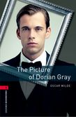
The flaws of real life Introduction: Divide students in two groups. One group looks for The Great Gatsby in Bookworms collection and the other group looks for The Picture of Dorian Gray. Prepare a brief biography of Oscar Wilde and F. Scott Fitzgerald.

Slide 4
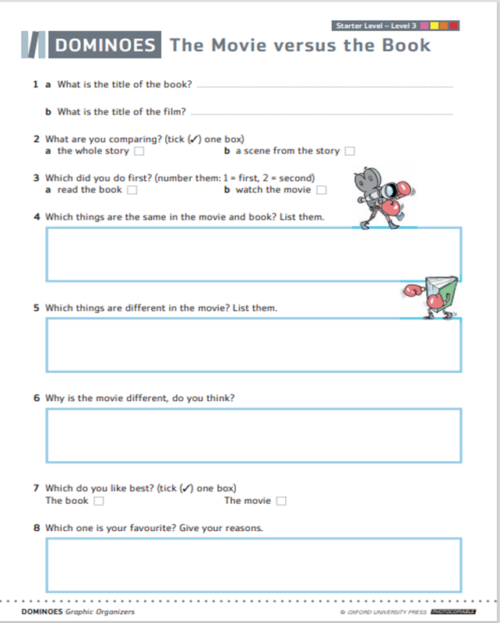
In your group discuss the following questions:
Have you ever watched a movie and read a book with the same title?
If yes, which one?
What did you like best, a book or a movie?
Why?
Complete the worksheet The Movie versus the Book individually and then talk about it in pairs or groups.
If you haven’t seen and read the same movie and book, think about possible differences and similarities.

Slide 5
Do you know anything about these movies or books? What genres do they belong to? What are they about? Do you think that these two books have something in common? Watch the trailers and decide.
Notes:
https://www.youtube.com/watch?v=sN183rJltNM

Slide 6
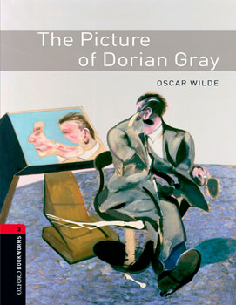
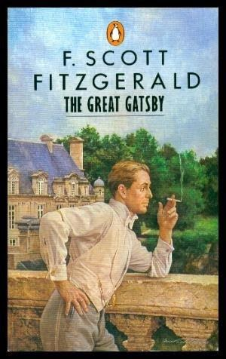
In your group, do the „before reading”
activities at the end of the book.
Read the titles of all chapters and
predict in your group what is going to happen in each one.
Record your team’s predictions.
Exchange information on the books between the groups.
This Photo by Unknown Author is licensed under CC BY-SA-NC

Slide 7
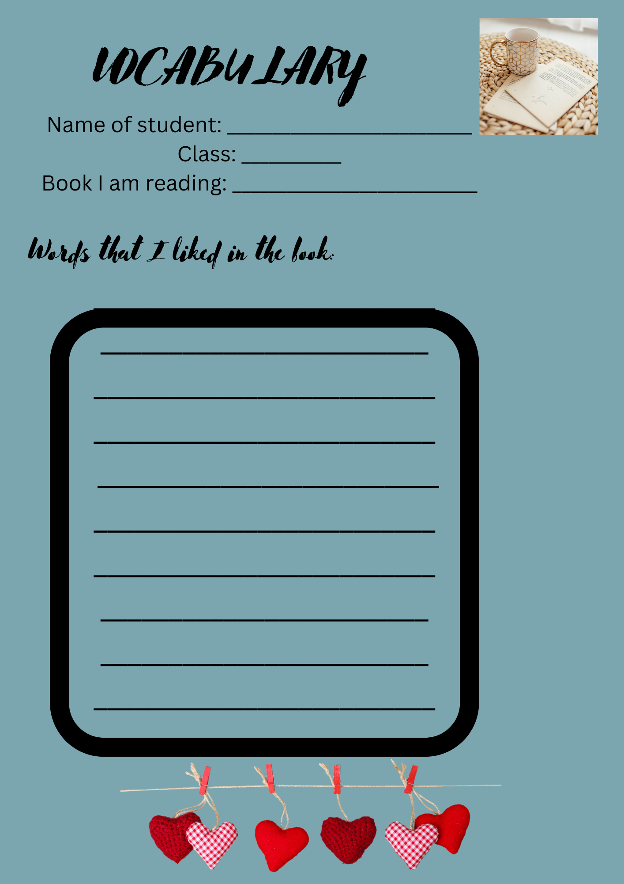
While-reading and after-reading activities (homework):
Find the meaning of any unknown words (dictionary) and add them to your vocabulary. Create a short list of new words that you liked.
Underline the most important parts, facts, scenes, descriptions (...) Do the while-reading activities at the end of the book.
After reading, do the exercises at the end of the book.

Slide 8
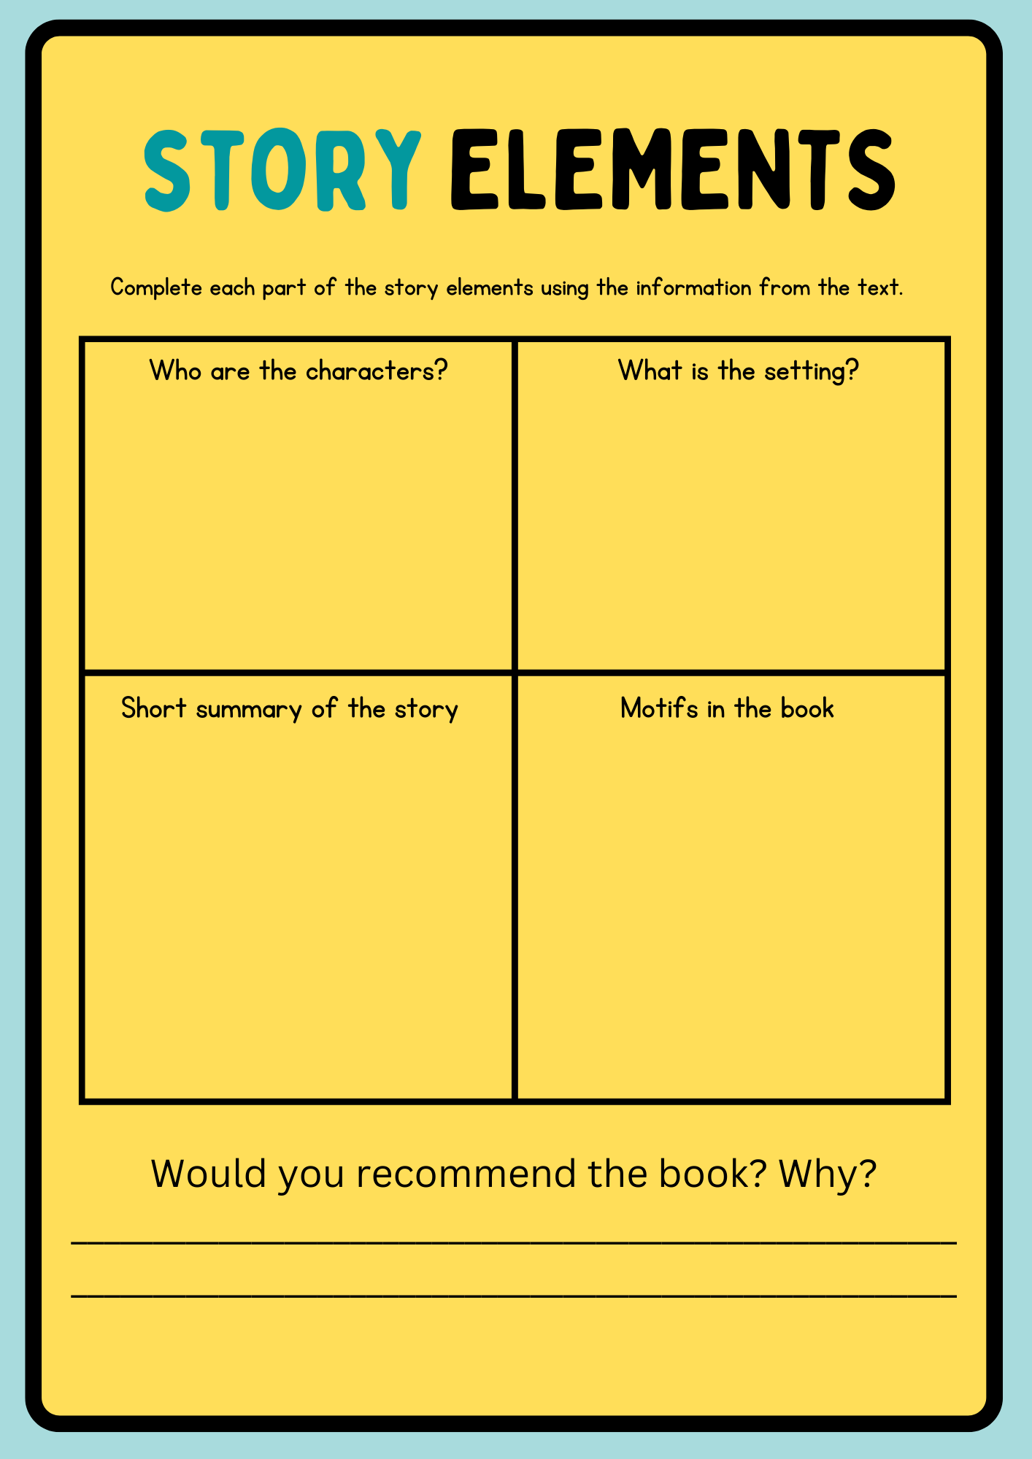
Lesson 2: Short discussion
Retell the story from the book you have read- use your Story Summary worksheet to remind yourself of the plot
Go through your vocabulary list and tell the class why you liked those words
Tell your class which parts you underlined in the book and why?
Would you recommend your book? Why yes/no?

Slide 9
Wrap-up: Time to have fun! Project tasks: It’s time to be creative and do your project work. ☺ You can choose between these ideas or do all of them: 1 Fashionable Gatsby-style party with Dorian’s dinner-style party 2 Create your own version of the end of the story 3 Watch film and compare it with a book 4 Make a viral Tik Tok commercial for your book Find more about all the options on the next few slides.

Slide 10
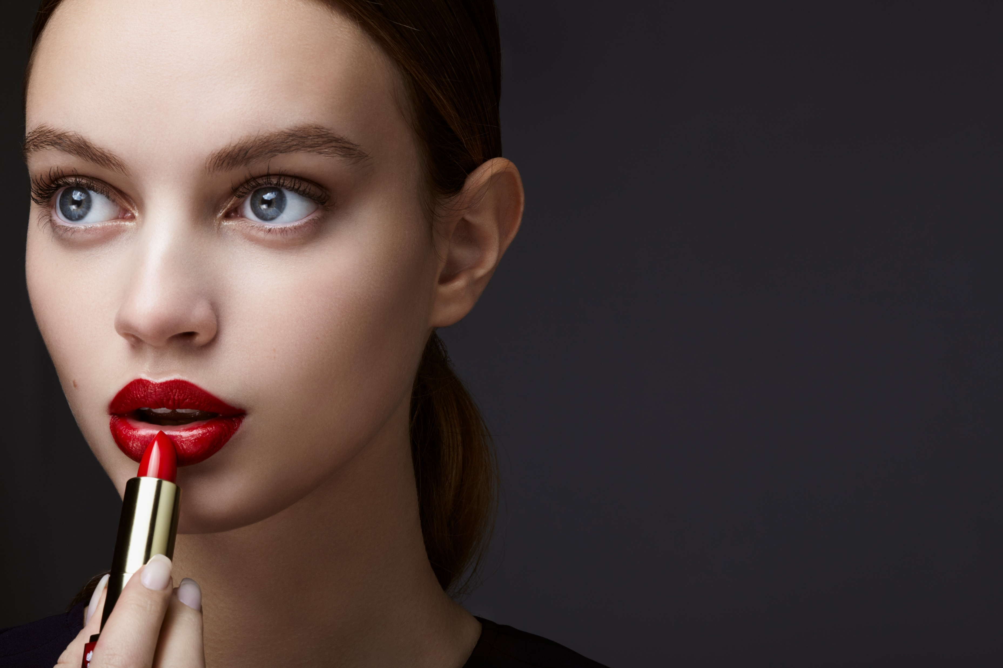
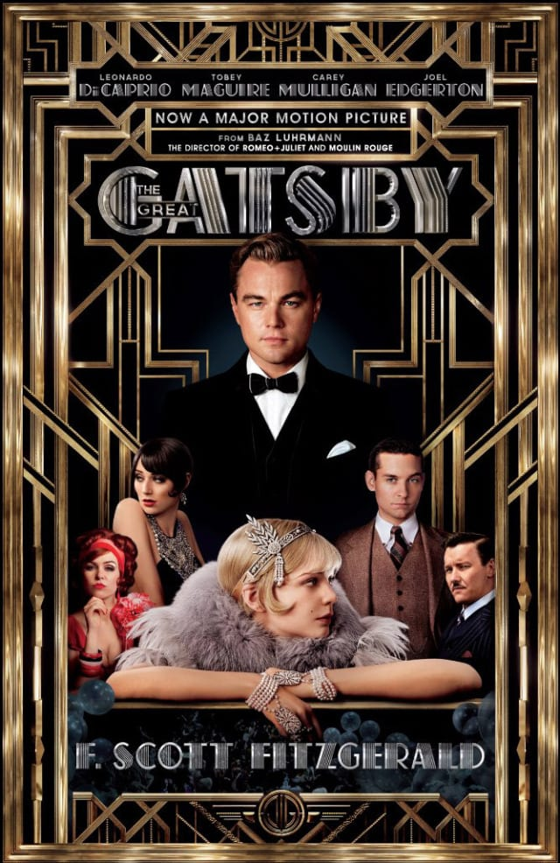
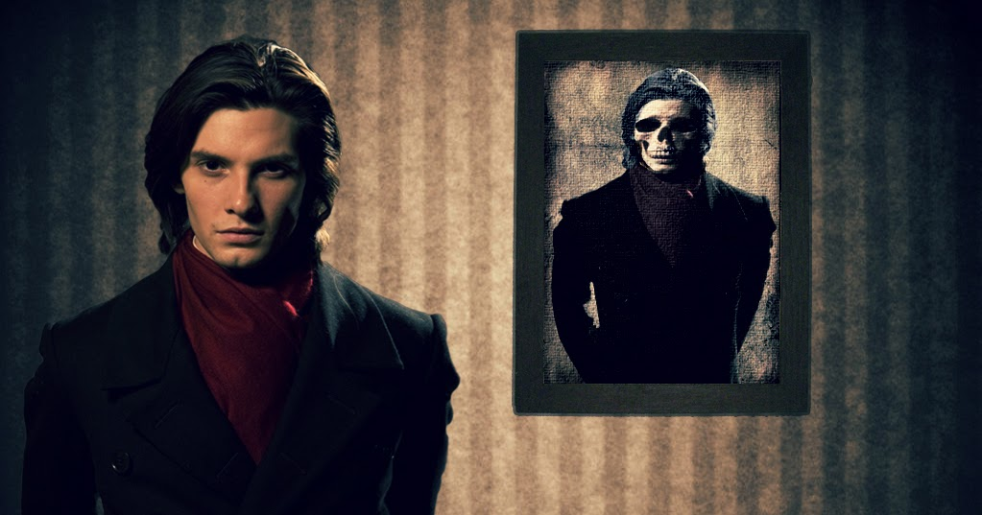
Fashionable Gatsby-style party with Dorian’s dinner-style party Let’s organize a party! Share tasks: 1)students whose task is to find appropriate music for the party 2)students who want to find appropriate Gatsby style clothes and dress up 3) students who want to plan a menu for Dorian’s dinner style party. Include an invitation which is also with a characteristic of hedonism. Be creative and have fun! Play music, dress up and eat like real rich hedonists. Make a video of your party and share it with #englishisfun
This Photo by Unknown Author is licensed under CC BY-SA-NC
This Photo by Unknown Author is licensed under CC BY-SA

Slide 11
Fan fiction-write your own end of the story
In groups or on your own write a new version of the end of the story.
Sometimes book fans do not like how the story ends and they would like their favourite characters to end differently.
Discuss the following questions before you start writing:
Who are the characters you want to include?
Where does the story happen? Is it the same place as in the book or some other place?
What happens in your version of the story?
What vocabulary will you be using? Write down some key words. Those words might be in your vocabulary list.
5) How does the story end?

Slide 12
Comparison of a film and a book task Think of the possible differences between a book and a film. We have already talked about it. You should watch a film after having read the book of your choice and fill in the worksheet. Take into consideration setting, characters and plot events. What do you prefer more? A book or a film? Give reasons for your opinion.

Slide 13
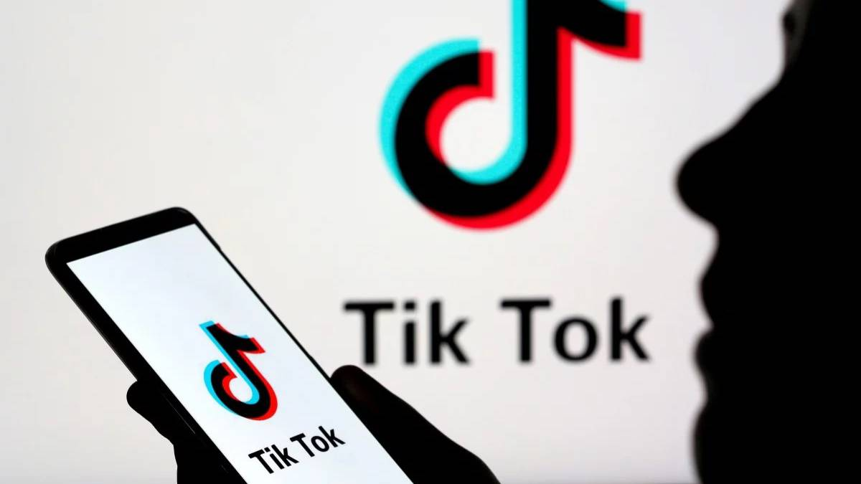
Make a viral Tik Tok commercial for your book
You want to convince other people to buy or read the book you liked by making a short viral Tik Tok video. You can create your video in pairs or on your own.
This video should provide excitement so think about the sound choice and the length of the clip.
Do you want to show the book cover, or do you want to show yourself while talking? It is up to you as long as you succeed in convincing people to read the book of your choice. ☺
When you create the video you can post it in class portfolio like Seesaw or any other and watch together. You can also vote for the most convincing video. ☺
This Photo by Unknown Author is licensed under CC BY-SA-NC

Slide 14
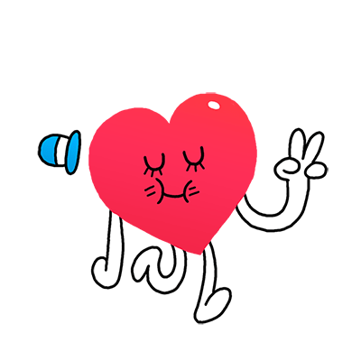
Lesson 3
Final part ☺
How did you like the workshops?
Which one was the best or which part of the workshop did you enjoy?
Did you cooperate with your peers?
Would you like to change anything?
Share your opinion on https://padlet.com/ or on a piece of paper.
This Photo by Unknown Author is licensed under CC BY-SA

Slide 15
Prof. Silvija Pećanac Bačić
Srednja škola Vela Luka
Notes:
Photo credit: https://www.vecteezy.com/vector-art/1220888-the-world-belongs-to-those-who-read-quote
15

