Slide 2
Looking for a page-turner?

Slide 3
Outcome
Write a book review
Design a two-day itinerary for a trip to London

Slide 4
Flipped classroom 1 Task (B2)
Watch this short video about the life and work of Charles Dickens to prepare for the next class
(students can also use the following link https://www.youtube.com/watch?v=unKuZ2wlNdw)

Slide 5
Flipped classroom 1 – Task (B2)

Slide 6
or Flipped classroom 2 Task (B1)
Students prepare for the next class and search online to find out most important facts about Charles Dickens, his life and work. Suggest the following source:
https://www.britannica.com/biography/Charles-Dickens-British-novelist
Ta fotografija korisnika Nepoznat autor: licenca CC BY-NC-ND

Slide 7
In class – Flipped Classroom 1
3 things you have learned about Charles Dickens
2 things you find interesting
1 thing you would like to find out

Slide 8
In class – Flipped Classroom 2
Where was Charles Dickens born?
In which century did he live?
What genre of writing is Dickens most famous for?
Which city did Dickens mostly write about?
Can you name at least 4 titles of his works?

Slide 9
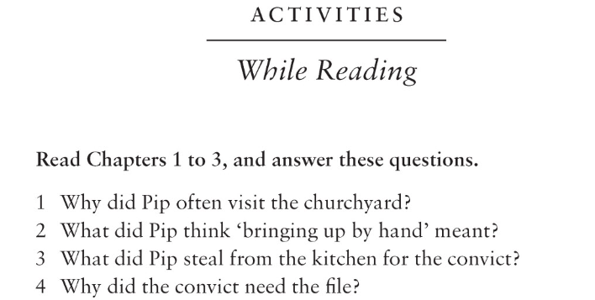
Great expectations - Chapter 1 (in class)
Read and listen to chapters 1-3 of Charles Dickens’ novel Great Expectations.
Answer the questions in the While Reading section.
Underline the parts you liked or find most interesting.

Slide 10
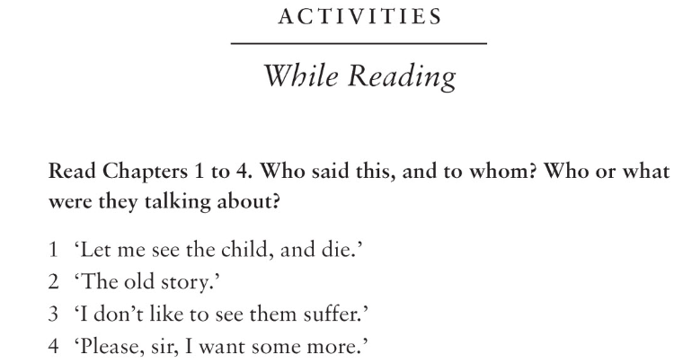
Oliver Twist - Chapter 1 (in class)
Read and listen to chapters 1-4 of Charles Dickens’ novel Oliver Twist.
Answer the questions in the While Reading section.
Underline the parts you liked or find most interesting.

Slide 11
Reading assignment
One half of the class chooses Great expectations and the other half Oliver Twist to read at home.

Slide 12
Back in class
TASK
In their pairs students present the books they have read.
After giving general information about the book, try to persuade your partner to read the book you have just read.
These phrases might help you: Why don’t you think about (consider something)… It might be a good idea to…; Perhaps you could…; I would appreciate it if, (+Past Simple); I can assure/guarantee you that… Surely you have to agree that…
Students discuss who presented more persuasive arguments.

Slide 13
Follow-up
TASK A
Your teacher has asked you to write a book review for the school magazine. Write your review describing the book and say what you liked and didn’t like about it.
Ta fotografija korisnika Nepoznat autor: licenca CC BY

Slide 14
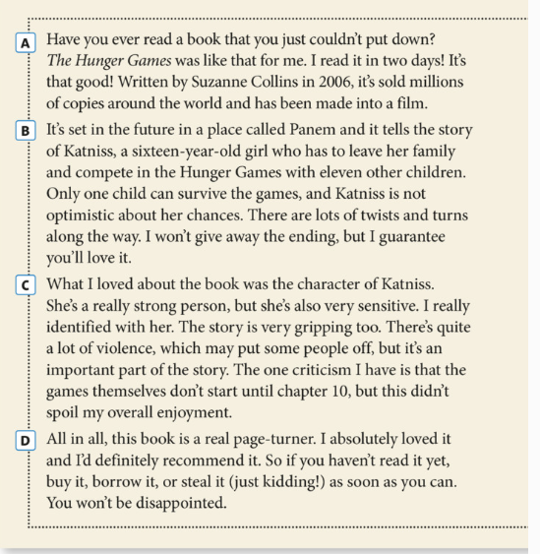
Example: If you are hungry for a good book, read on!
Notes:
Source: Solutions 3rd Edition Intermediate, Student’s book, OUP

Slide 15
Follow-up
Use the following writing plan:
Choose a title to catch the reader's attention
PARAGRAPH 1 - INTRODUCTION
Give your opinion of the book for the first time and some background information about the book.
PARAGRAPH 2
Briefly describe the plot and the characters (use the present tense).
PARAGRAPH 3
Say why you liked the book and mention something you did not like.
PARAGRAPH 4
Restate your opinion of the book.

Slide 16
Book Review - Checklist
Students can use the Checklist for self-assessment:
Have you…
given your review a title and an interesting introduction?
used an appropriate style?
given your article a logical structure?
used the present tense to describe the plot and characters?
checked your grammar and spelling?
The checklist can be used for self-assessment as well as for peer-assessment. It’s up to the teacher.

Slide 17
Follow-up
Optional:
Students upload their book reviews into their digital portfolios (OneNote) and/or design a padlet: https://hr.padlet.com with the collection of their book reviews for the school website.
Extra help for using the padlet: https://www.youtube.com/watch?v=x9IQVofS43I

Slide 18
Follow-up
TASK B
Students plan a trip to London.
Research London and its tourist attractions online.
Design a two-day itinerary for a trip to London. They should think of tourist attractions, entertainment, museums, restaurants etc. Students can use the followig site: https://www.tripadvisor.co.uk/Attractions-g186338
Present your itinerary in a two-minute speech.
The class votes for the itinerary they like best.

Slide 19
Follow-up
Itinerary plan:
Describe what will happen on each day.
Include:
arrival and departure times
details of accommodation
restaurants/places to grab a bite
Attractions to visit
shows/events to see
Remember to make it sound as attractive as possible.

Slide 20
Notes:
Photo credit: https://www.vecteezy.com/vector-art/1220888-the-world-belongs-to-those-who-read-quote
20

