Slide 2
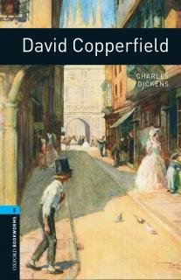
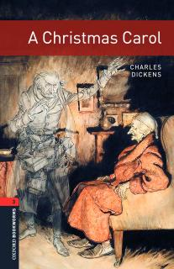
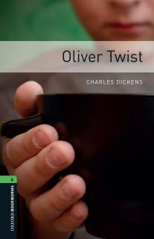
Warm up Lesson one ☺ What do these books have in common?

Slide 3
Warm up
Besides the fact that Charles Dickens wrote them is there anything else that these books might have in common? Think about it. ☺
If you need hint : F_O_ ☺
And the answer to the question above is food. All of the books from the first slide contain food reference.
Charles Dickens was a real foodie? What does this word mean?

Slide 4
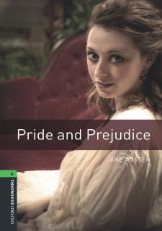
Workshop Food for thought
Do you happen to know any other book that contains food reference as well?

Slide 5
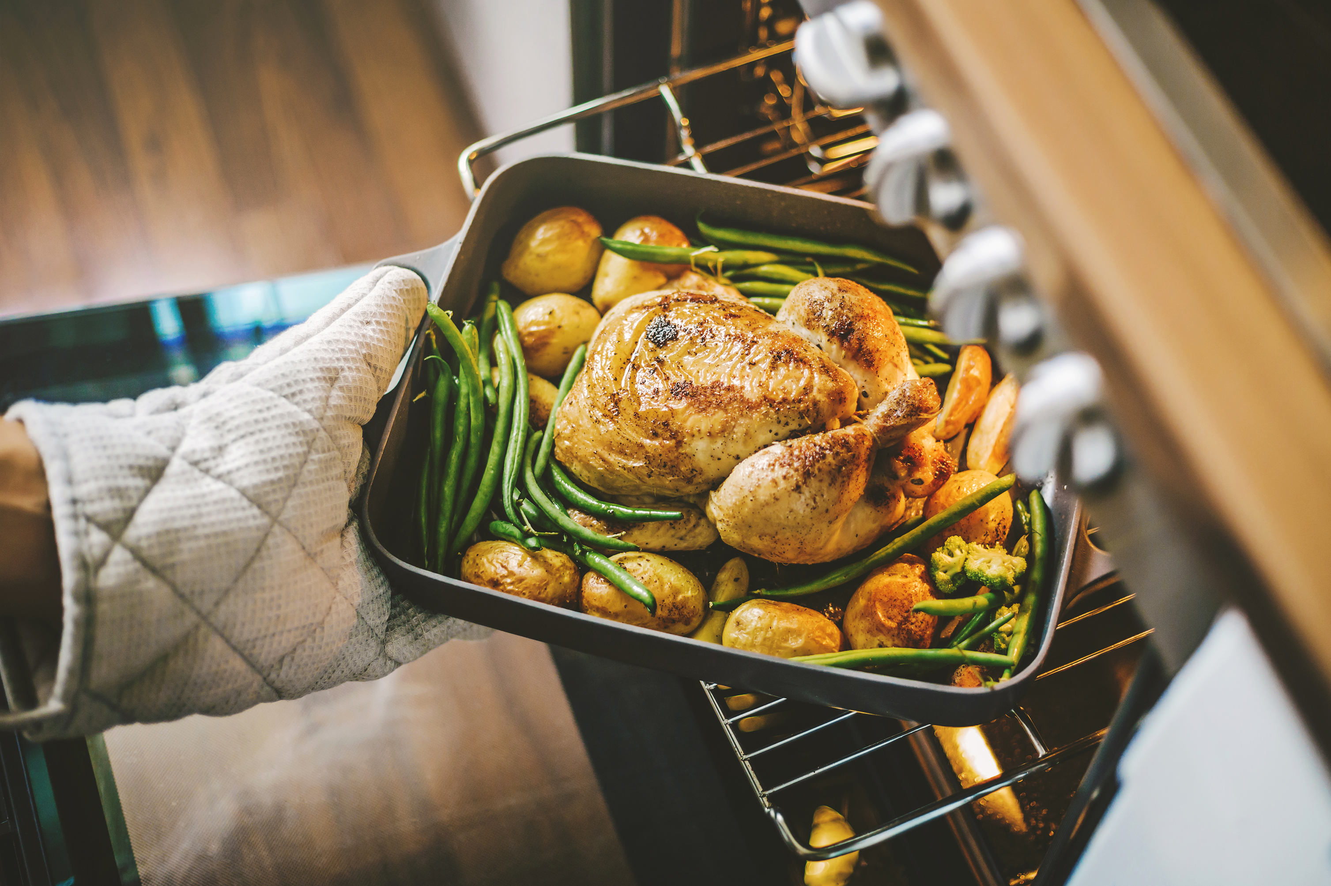
Workshop Food for thought
In Charles Dickens’ novels it is visible that he takes pleasure in English food.
What do you think might be the reason for so many food mentions?
Charles Dickens uses food as a metaphor. A metaphor for what?
Charles Dickens uses food as a metaphor to reflect prevalent class distinctions.

Slide 6
Workshop Food for thought
Choose a book you are going to read and find it in Bookworms collection in your ORC.
There are activities at the end of the book you could do as well.
Can you predict what kind of food might be mentioned in the book you chose?
Record your predictions.
Exchange information on the books between other students.

Slide 7
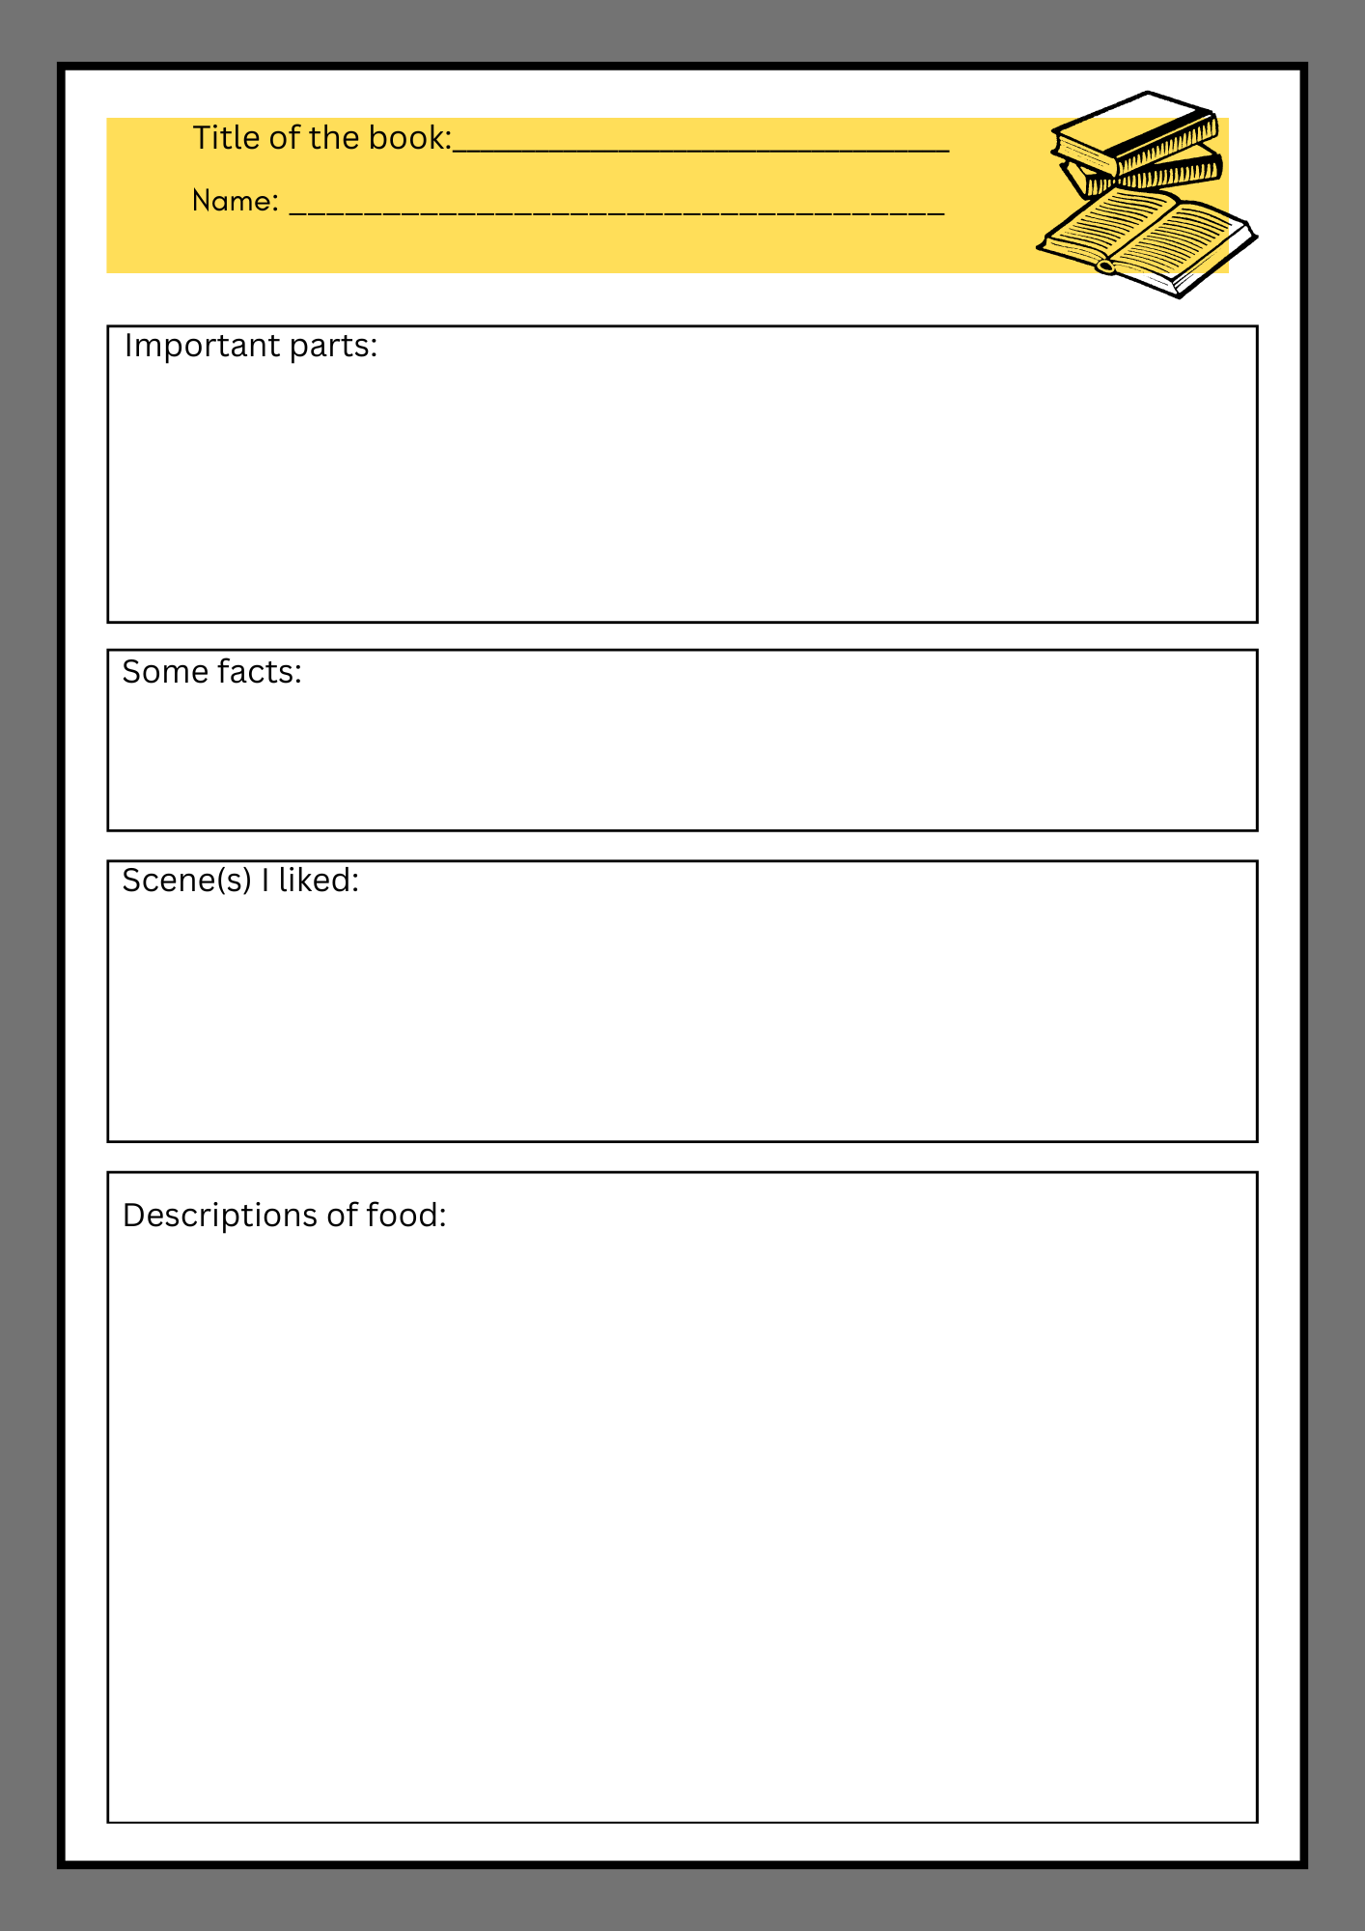
Food for thought While-reading and after-reading activities (homework):
While reading the book at home find the meaning of any unknown words (dictionary) and add them to your vocabulary in ORC.
Underline some of the most important parts, facts, scenes and descriptions of food and write them on the worksheet.
You can also do the while-reading activities at the end of the book.
After you have finished reading, you can do the exercises at the end of the book.

Slide 8
Food for thought Lesson two 1. Short discussion 2. Project task

Slide 9
Workshop Food for thought Short discussion
Go through your vocabulary list in ORC and choose some words to share with the class. Tell the definition of the word or expression and have your colleagues guess the word/expression.
Tell your class which parts you underlined in the book and why? Refer to your worksheet.
Would you recommend your book? Why yes/no?

Slide 10
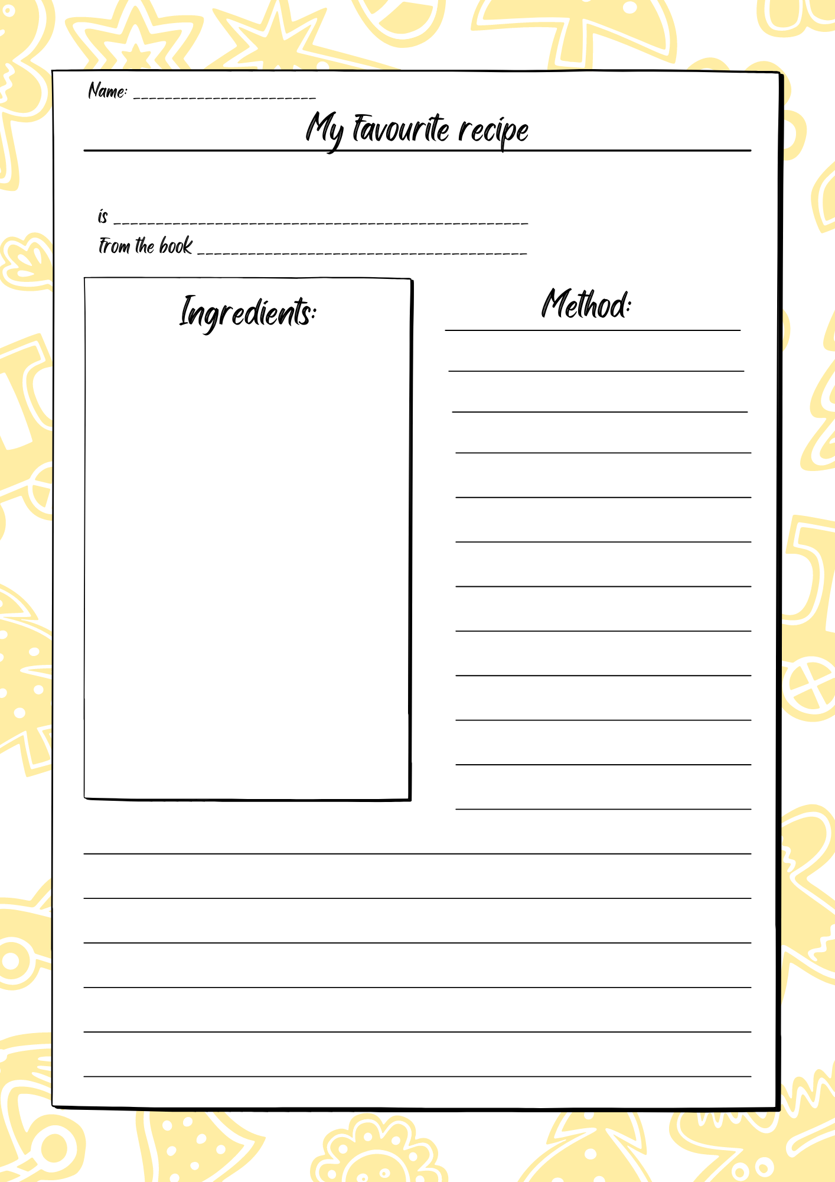
Workshop Food for thought Wrap-up: Time to have fun! ☺ Project task: Part one
Choose food from the book you have read in order to write a recipe and then prepare it.
Write down the recipe on the worksheet to share with the class. For example, scones (a type of pastry that is often served at breakfast or tea in Britain) are one of the food references in C. Dickens’ novels. You can find a recipe online. ☺

Slide 11
Project task: Part two ☺ Video and/or photo collage Video task
Make video recipe to share with the class. If you want this can be a group work.
Your video should contain clips of important recipe parts and not be longer than a few minutes.
You can bring all of the ingredients and prepare it at school kitchen (if possible) and make a video of the whole preparation process. You can also prepare it at home.
Useful digital tools for making food preparation videos are Tik Tok or Animoto.
https://animoto.com/resources/tutorials/how-to-create-a-video-in-animoto
https://www.realsimple.com/food-recipes/cooking-tips-techniques/how-to-make-a-cooking-tiktok

Slide 12
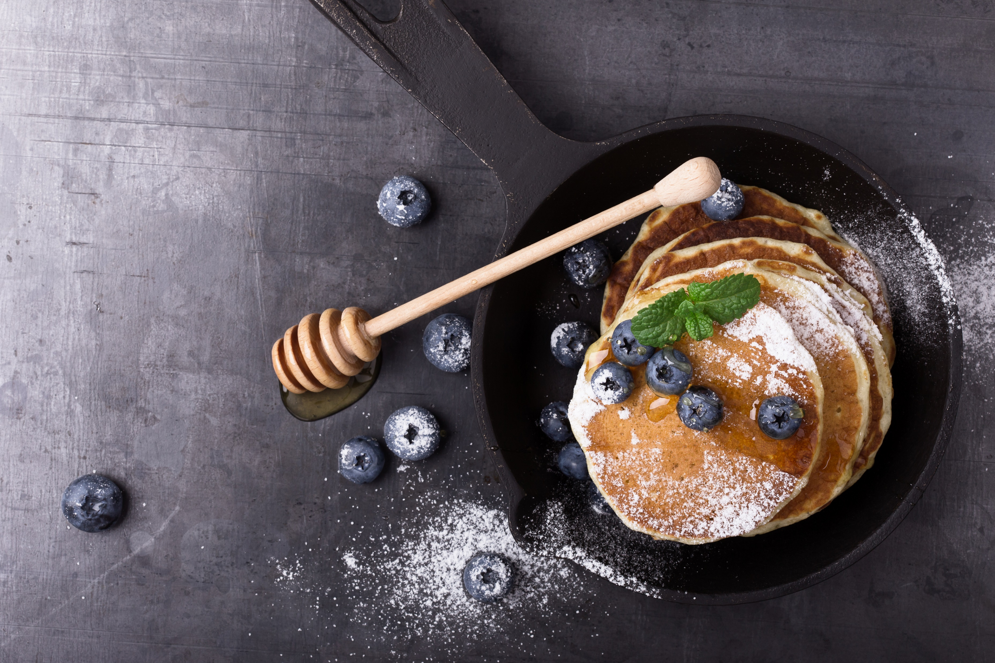
Photo collage
You can choose to take the photo of your prepared food and make class food collage based on classic novels. ☺
Canva is an excellent digital tool to make this kind of collage.

Slide 13
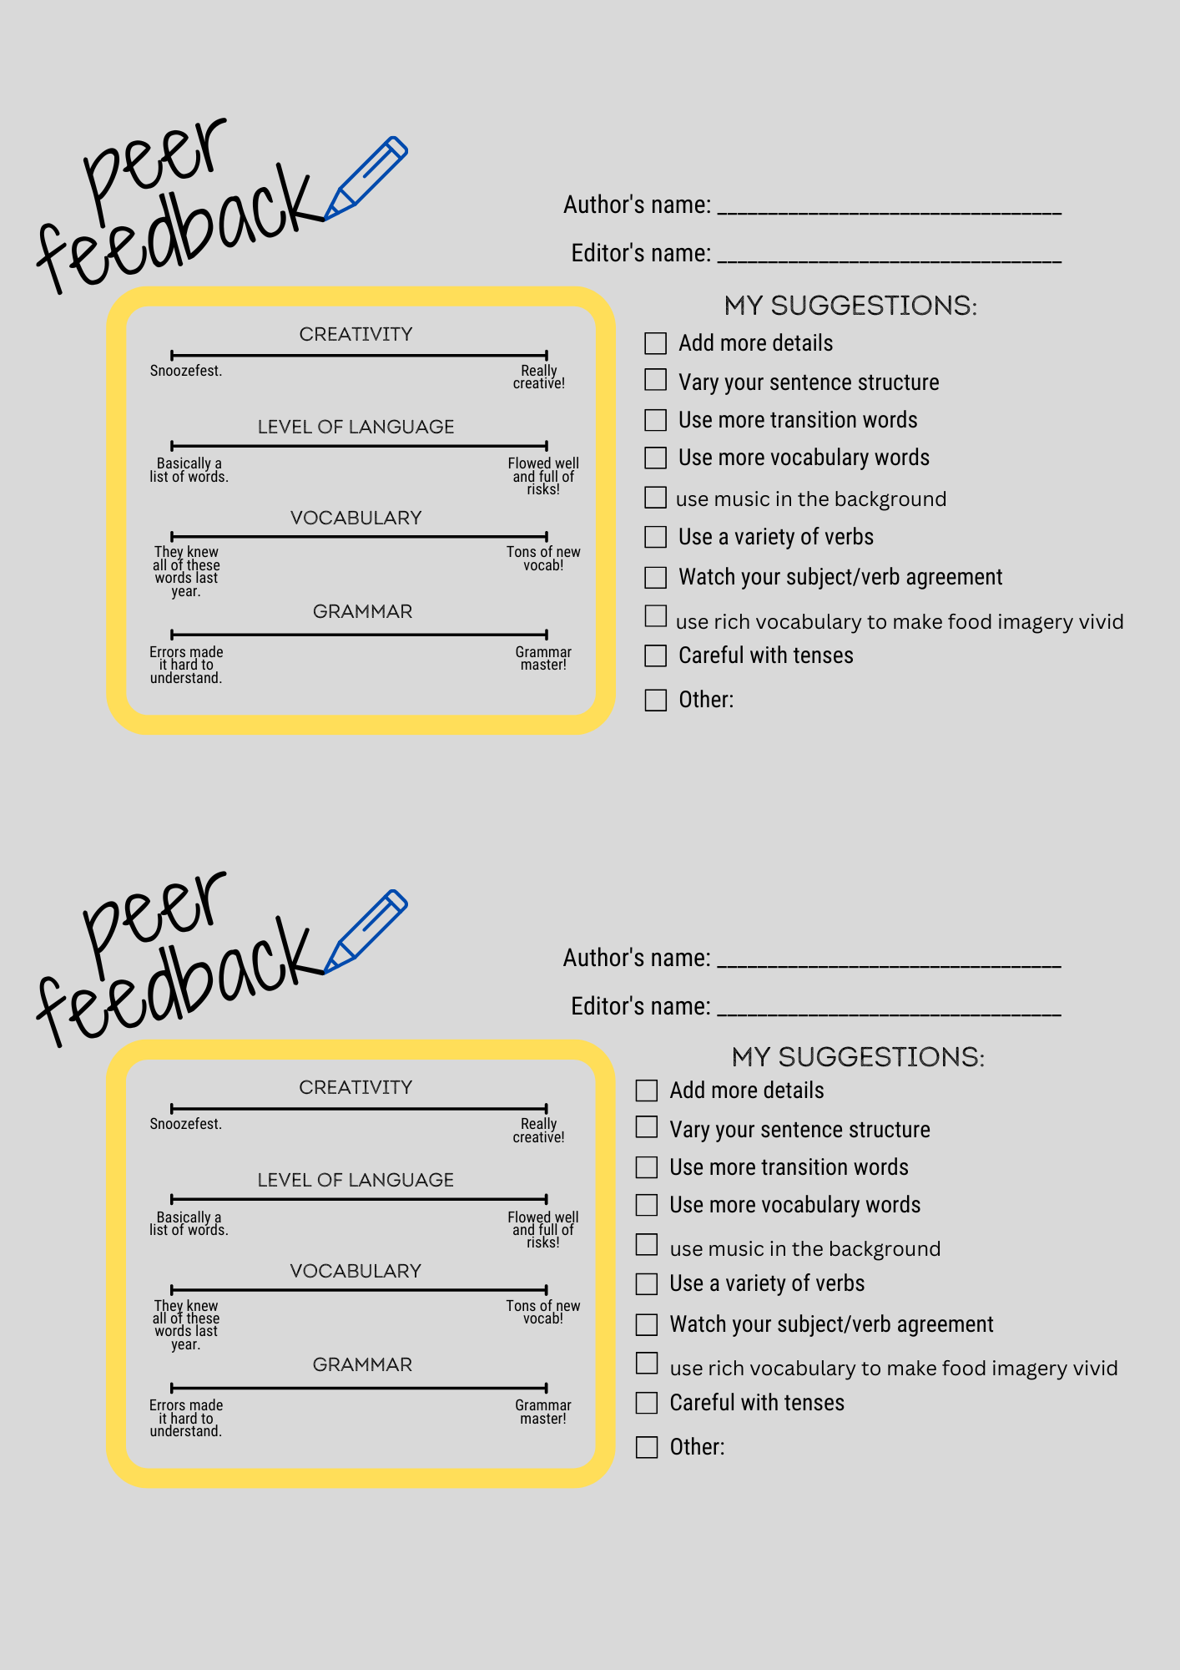
Food for thought Lesson three: Evaluation part ☺
While watching the video recipes of your colleagues please evaluate.
Think of things that were excellent and parts that might need improvement.
You can use evaluation sheet or simply make notes and share it in www.padlet.com
In case your class decides to make photo collage you can vote for the most appealing design of the poster. ☺

Slide 14
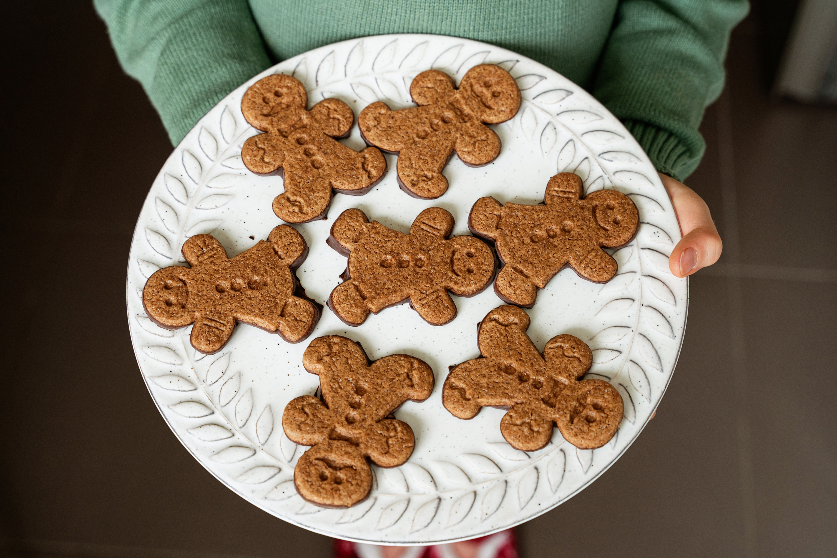
Final part ☺
How did you like the workshops?
Which recipe/food did you like?
Which part of the workshop did you enjoy? Maybe food tasting?
Did you cooperate with your peers?
Would you like to change anything?
Share your opinion on https://padlet.com/ or on a piece of paper.

Slide 15
Prof. Silvija Pećanac Bačić
Srednja škola Vela Luka
Notes:
Photo credit: https://www.vecteezy.com/vector-art/1220888-the-world-belongs-to-those-who-read-quote
15

