Slide 2
WORKSHOP: Reading Teams

Slide 3
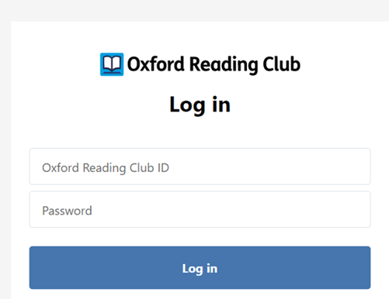
Let’s get started!
Step 1:
Click here and log in to Oxford Reading Club by using your ID and password :
Step 2:
Find the collection: Dominoes

Slide 4
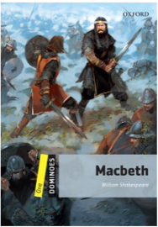
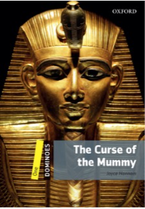
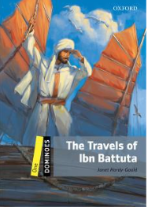
What can we discover by reading?
Quickly skim and scan the books within Dominoes collection and write at least
three titles in the correct column:
Compare your answers with other classmates.
What category do you like best? Why?
TV & Film Adventure | World Literature | Mystery & Horror | Story Collections | True Tales | Human Interest

Slide 5
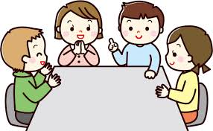
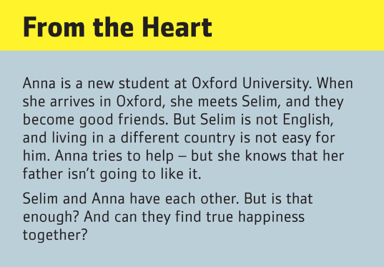
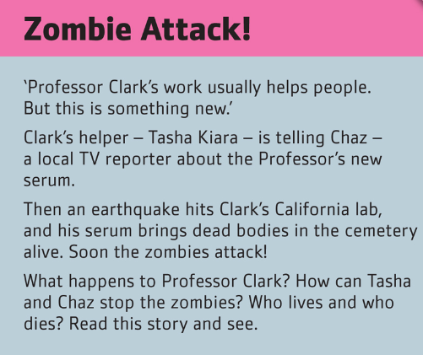
What would you really like to read?
Find a book within Dominoes collection that you would like to read.
Open the last page and read the short summary. Do you like it? Why?
In your Teams (groups of 5 pupils), talk about the plot of the book that you like. Other teammembers try to recognize your book in the ORC.
Notes:
Photo credit: https://kyoiku.sho.jp/89227/
5

Slide 6
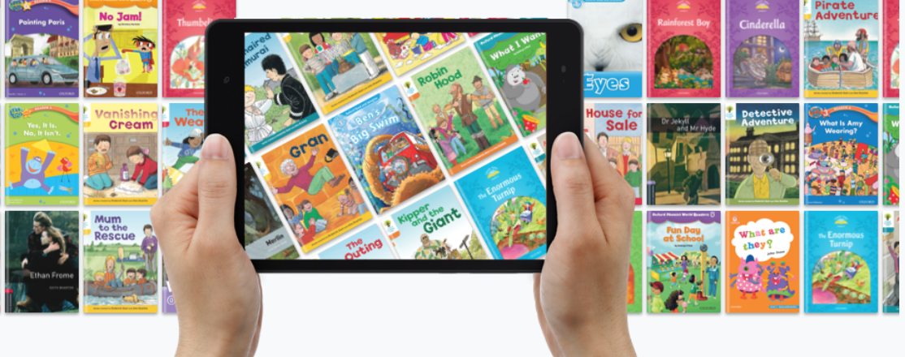
Read your way to better English in your Reading Teams! ☺
Choose a book from the Dominoes collection that your Team will be discovering.
Which one did you choose? Why? Compare with other teams.

Slide 7
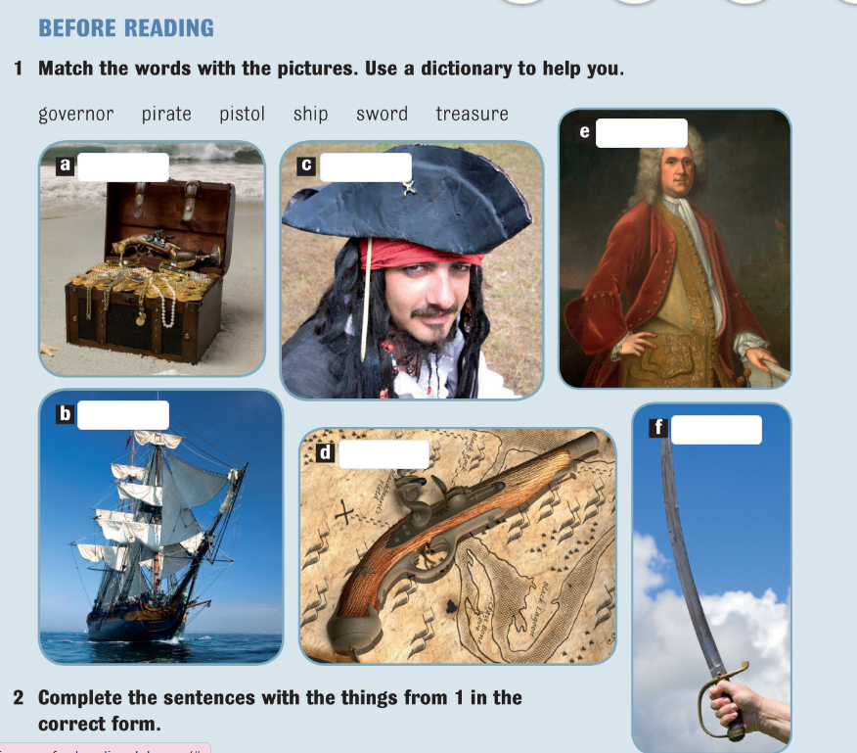
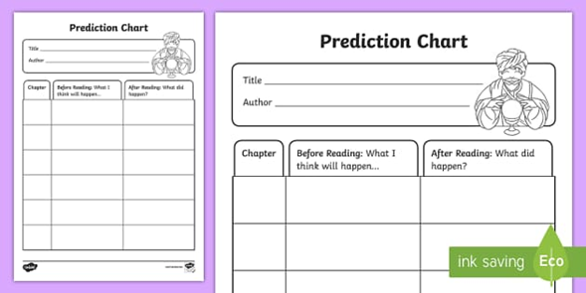
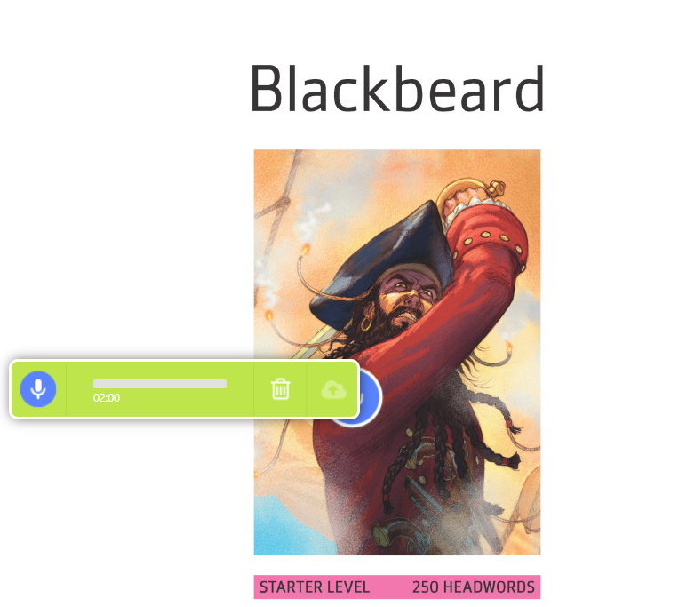
Pre-reading activities:
In your teams, do the „before reading”
activities (p.6). Check and comment your
answers.
Read the titles of all chapters and
predict in your team what is going to happen
in each chapter.
You can write notes in the prediction chart or
record your ideas and save it on the front page.
Extra idea:
Each student records prediction for one
chapter. Afterwards, everyone plays his/her
recording, and all together comment the
predictions.

Slide 8
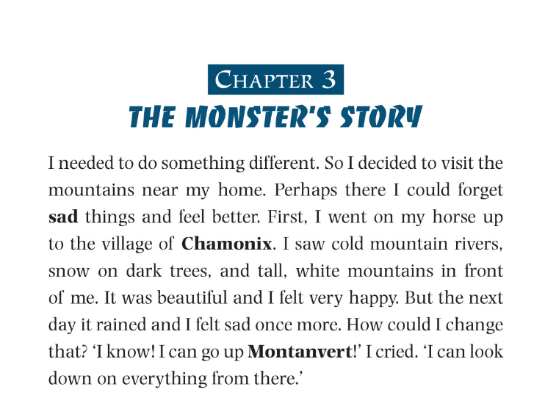
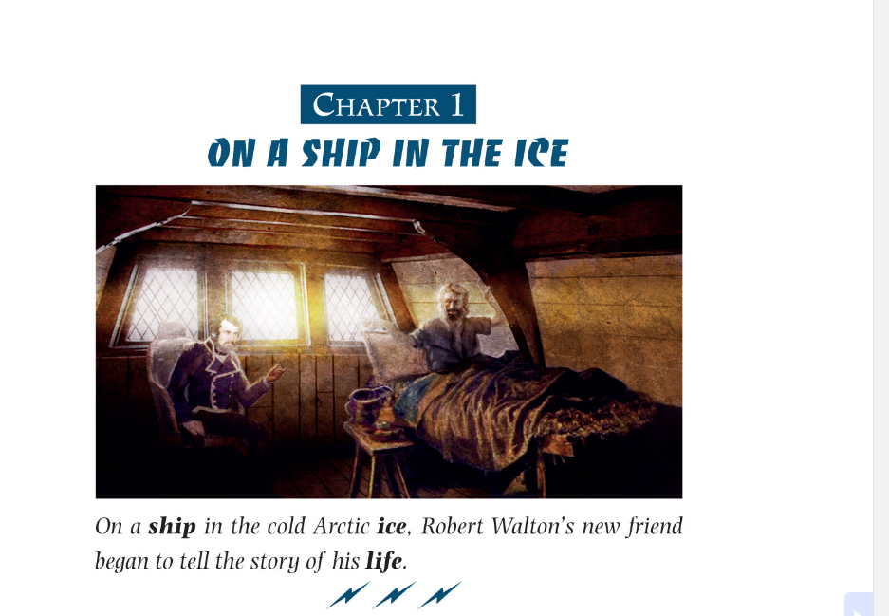
reading:
Read chapters :
depending on your level, you can read one or more chapters
You can read and/or listen
Use earphones if necessary
Determine pace and dialect

Slide 9
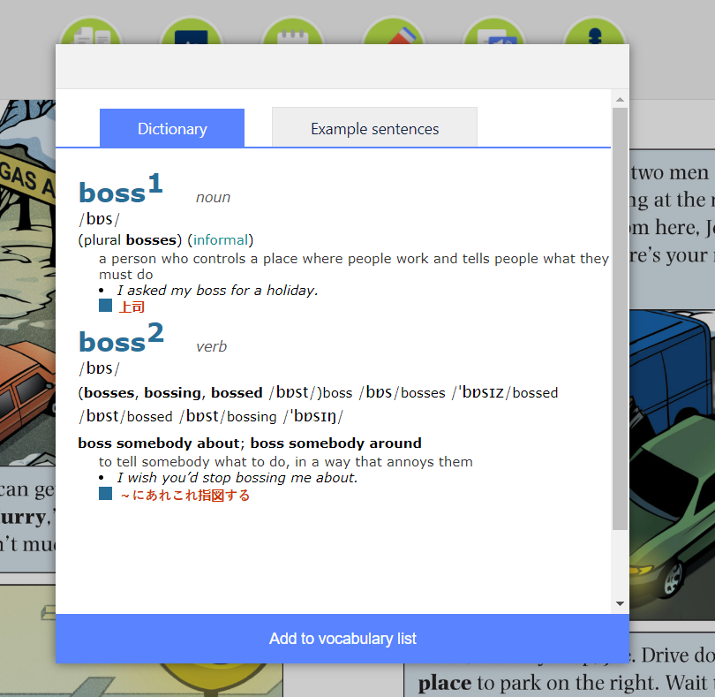
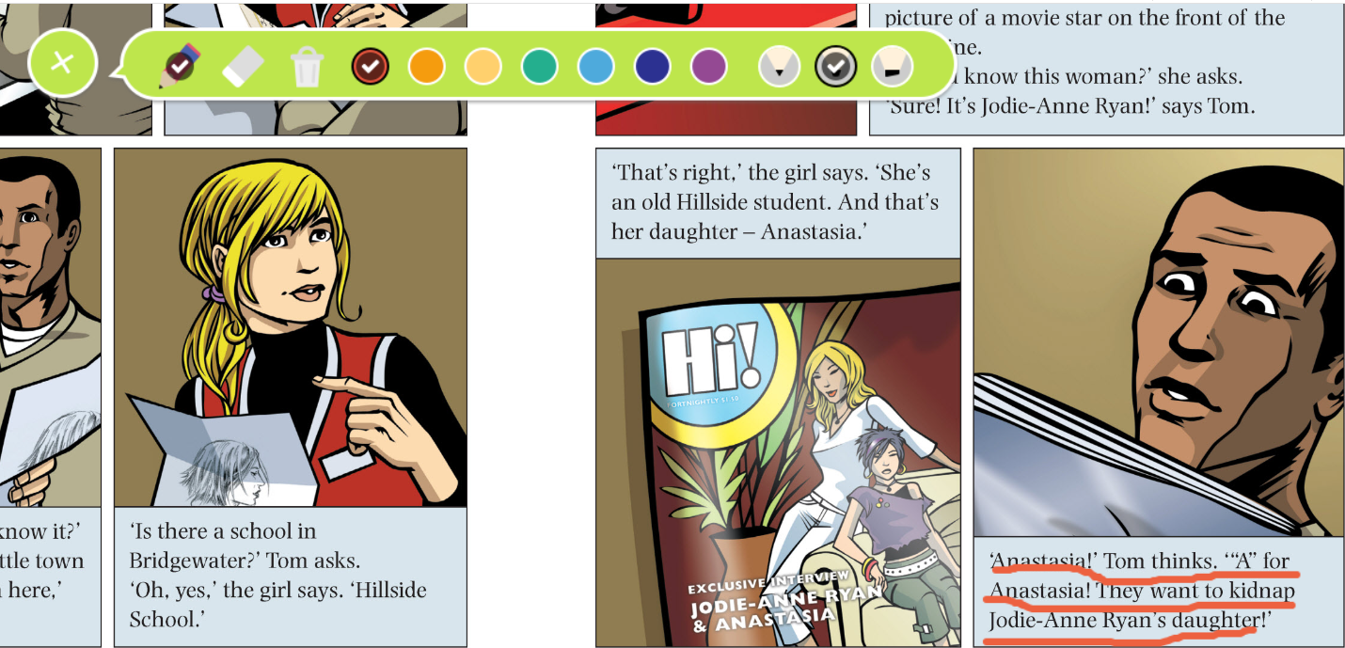
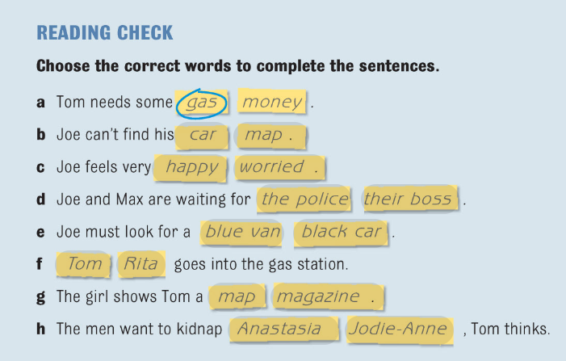
While-reading activities:
Find the meaning of any unknown
words (dictionary) and add them to your
vocabulary.
Underline the most interesting parts,
descriptions(...)
After each chapter, do the exercises
(reading comprehension, vocabulary and
prediction)
Compare and discuss the answers in
your Team.

Slide 10
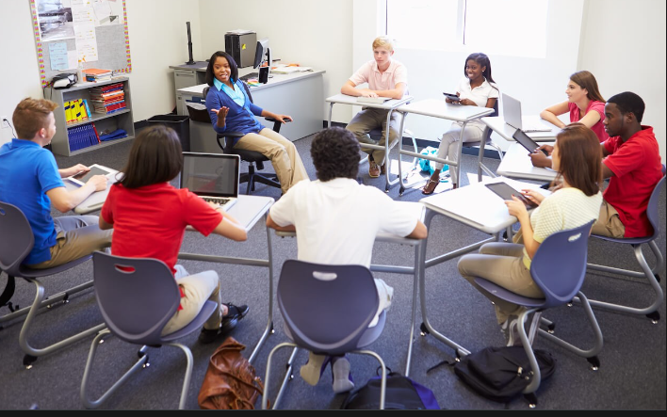
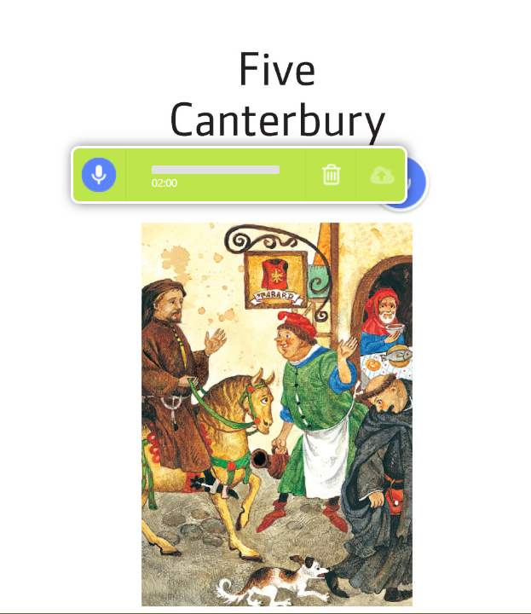
After-reading activities:
In your Team, discuss what your chapters were about.
You can use these example questions:
What is the book about?
Do you like it?
What have you underlined and why?
Were there many unknown words? (...)
Play your notes to see how good you are at predicting.
Notes:
Photo credit: https://www.schooloutfitters.com/blog/3-questions-to-ask-when-planning-your-21st-century-learning-environment
10

Slide 11
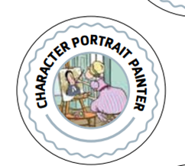
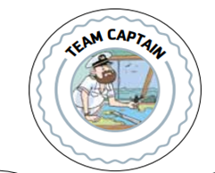
Reading Roles:
Every member of your Team has an important reading task! ☺
You can be:
Special Event Photographer
Team Captain
Picture Dictionary Compiler
Scenic Artist
Character Portrait Painter

Slide 12
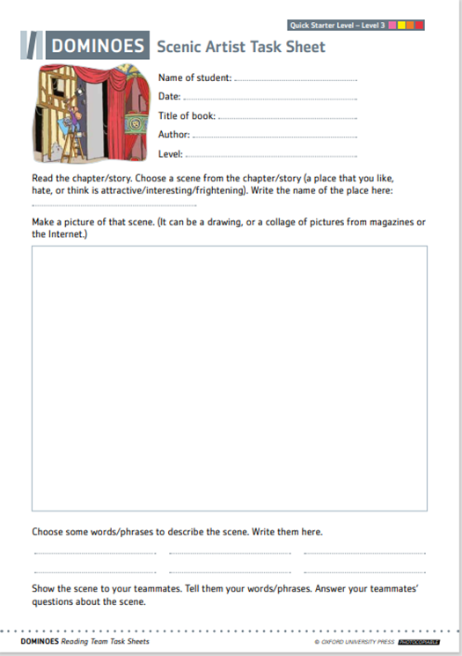
About Scenic Artist:
What are scenic artists’ roles?
Read about them in the Scenic Artist Task Sheet.
Do you like this role?
Who would like to be a Scenic Artist in your Team?
Congratulations Scenic Artist!
Here is your reading badge. ☺

Slide 13
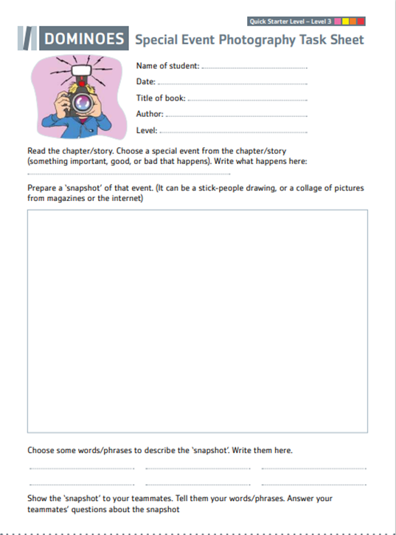
About Special Event Photographer:
What do photographers’ role include?
Read Special Event Photography Task Sheet and find out!
Do you like this role?
Who would like to be a special event photographer in your Team?
Congratulations Special Event Photographer!
Here is your reading badge. ☺

Slide 14
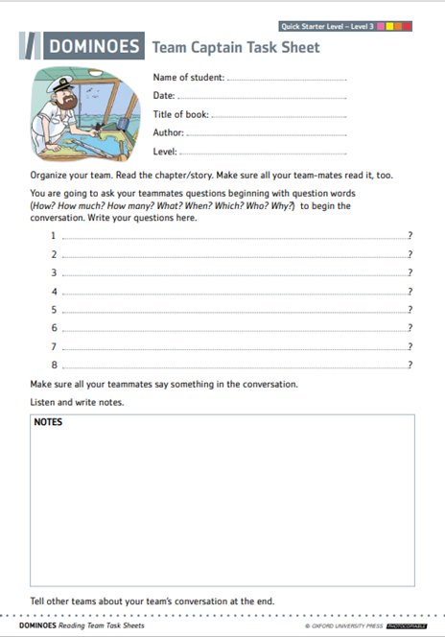
About Team Captain:
What do captains’ roles include?
Find all the tasks in Team Captain Task Sheet.
Do you like this role?
Who would like to be a Team Captain in your Reading Team?
Congratulations Team Captain!
Here is your reading badge. ☺

Slide 15
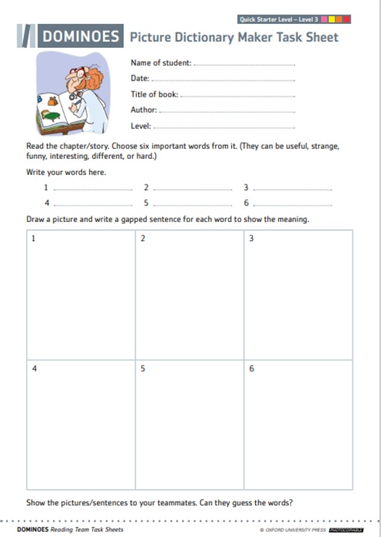
About Picture Dictionary Compiler:
What are the dictionary compilers tasks?
Look it up in the Picture Dictionary Maker Task Sheet.
Do you like this role?
Who would like to be a Picture Dictionary Maker in your Reading Team?
Congratulations on Picture Dictionary Compiler!
Here is your reading badge. ☺

Slide 16
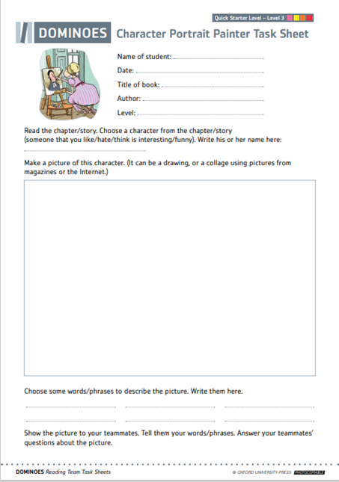
About Character Portrait Painter:
What are the painters' tasks?
Read about them in Character Portrait Painter Task Sheet.
Do you like this role?
Who would like to be a Character Portrait Painter in your Team?
Congratulations Character Portrait Painter!
Here is your reading badge. ☺

Slide 17
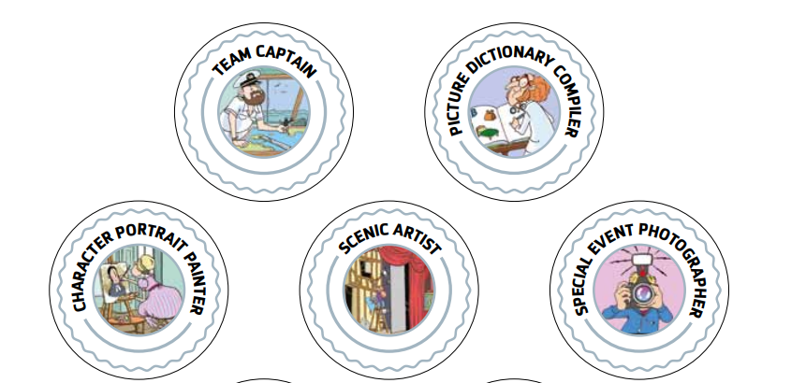
Remember to bring to your next workshop:
1)Your role badge
2) Your task sheet

Slide 18
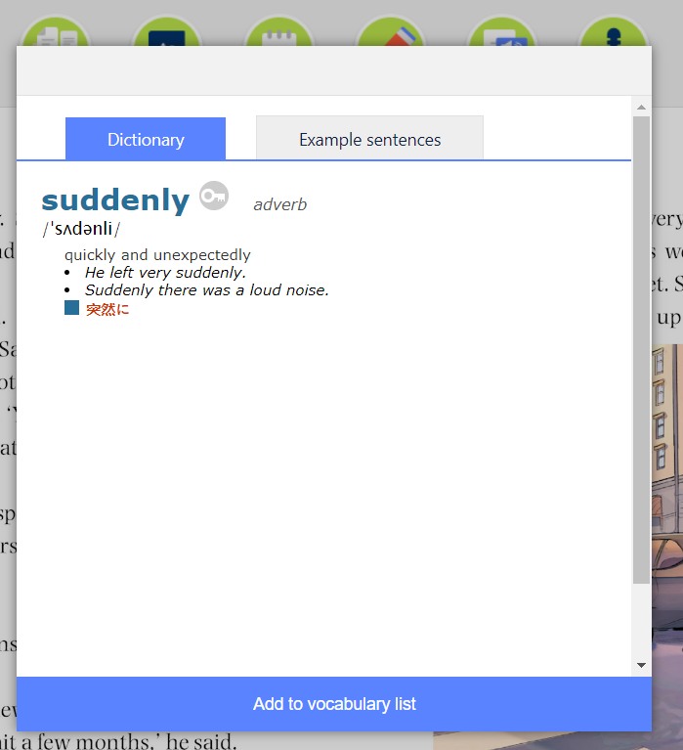
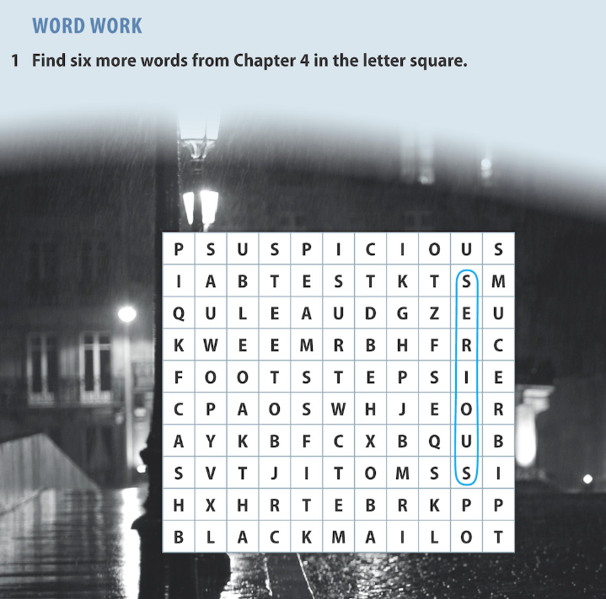
Finish your reader at home. Anywhere, anytime.
Your 5 tasks at home:
Make notes that will help you complete the role’s sheet. You can write them down in the notebook or record and save them in the ORC.
Use dictionary to find all unknown words and add them to your vocabulary list
If you want ☺, do the exercises within your e-book.
4) After you have read the entire e-book, it is important to complete your task sheet and prepare yourself for presenting the notes to other teammates.
5) The most important task for you is to ENJOY your reading. ☺
Notes:
https://www.freepik.com/premium-photo/portrait-happy-middle-eastern-family-using-laptop-together-home-arabic-parents-their-cute-little-daughter-relaxing-with-computer-couch-living-room-watching-movies-enjoying-weekend_22279835.htm
18

Slide 19
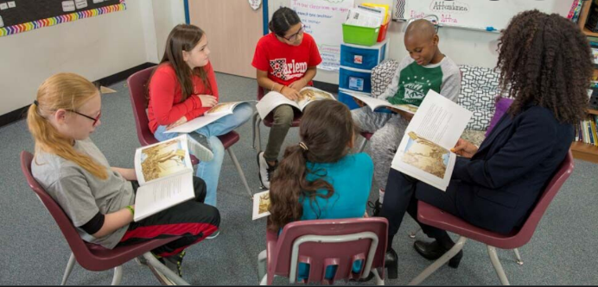
Workshop time! Class introduction
As a class, discuss the questions:
Which e-book was your Team reading?
Did you manage to read it all?
Did you stick to the schedule?
What was your role?
Was it fun?
Did you encounter any difficulties?
Would you recommend this title to your friends? Explain.
Gather in the Teams, sit in a circle so you can see and hear well each other, put your badges on and start the discussion. ☺
Notes:
https://fpblog.fountasandpinnell.com/teacher-tip-effective-practices-for-book-clubs
19

Slide 20
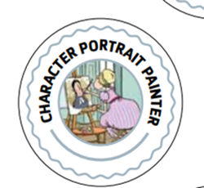
Workshop time- Reading Teams in action!
Team Captain:
opens the discussion with prepared questions
leads the discussion by making sure that everyone participate
writes notes about discussion
gives conclusion
and, in the end, reports to the other teams about his/her group disscusion by using his/her note
Special Event Photographer shows and describes his/her snapshot.
Others comment or ask questions.
Character Portrait Painter:
shows and describes his/her drawings/pictures that represent a character from the story
Other teammates comment and ask questions.
Picture Dictionary Maker shows his sentences/pictures to his/her teammates to guess the words.
Scenic Artist shows and describes his/her scene(s) by using previously prepaired vocabulary.
Can the rest of the team guess the scene?

Slide 21
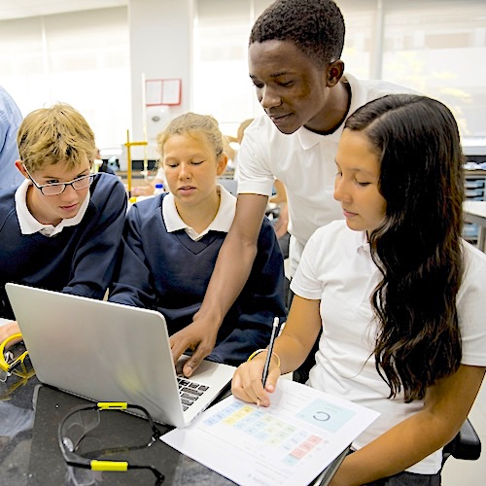
Workshop time-Finishing discussion
Team Captains report to the rest of the class on their discussion by using their notes and showing the worksheets.
The rest of teammates are welcome to jump in and comment. ☺
Pupils comment on their work and how they liked the discussion.
Pupils reflect on their group performance by answering a few questions:
https://docs.google.com/forms/d/1XTEAePTdQyAXr61RbzU4yHWFYQEg_a9iNzrAZKsUp7A/edit

Slide 22
Notes:
Photo credit: https://www.vecteezy.com/vector-art/1220888-the-world-belongs-to-those-who-read-quote
22

