Slide 2
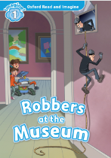
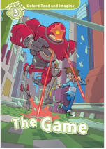
WORKSHOP: Read and Imagine

Slide 3
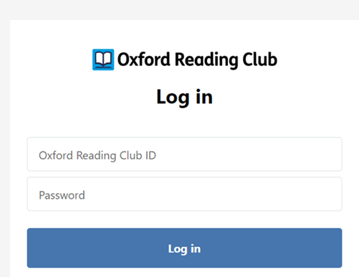
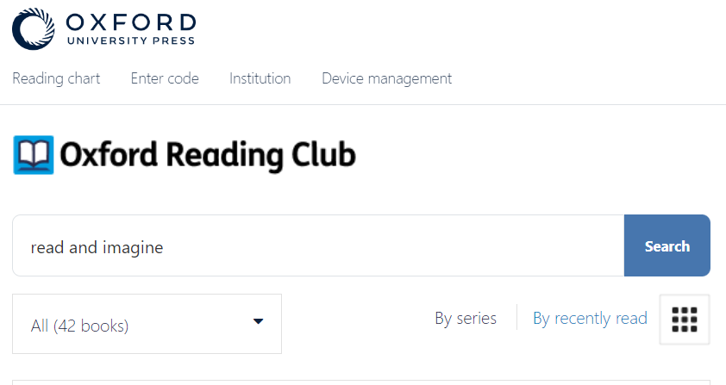
Let’s get started!
Step 1:
Click here and log in to Oxford Reading Club by using your ID and password :
Step 2:
Find the collection: Oxford Read and Imagine!

Slide 4
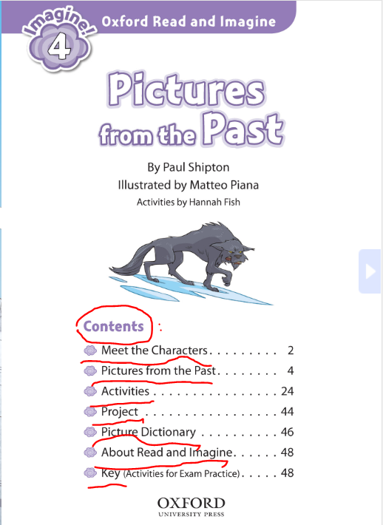
Fiction or Non-Fiction?
Quickly skim and scan the books within Oxford Read and Imagine collection:
Choose the title(s) that you like best. Explain why.
Decide on the books’ genre. Is it fiction or non-fiction?
Before deciding, watch carefully the video which explains the difference.
3) What’s the content of each book?
* a content- parts contained in a book with the number of the page they begin on
Notes:
Video credit: https://www.youtube.com/watch?v=QrUPneyZNf0
4

Slide 5
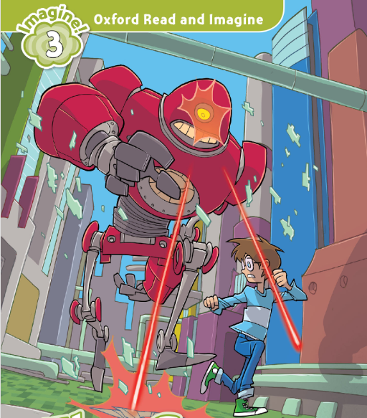
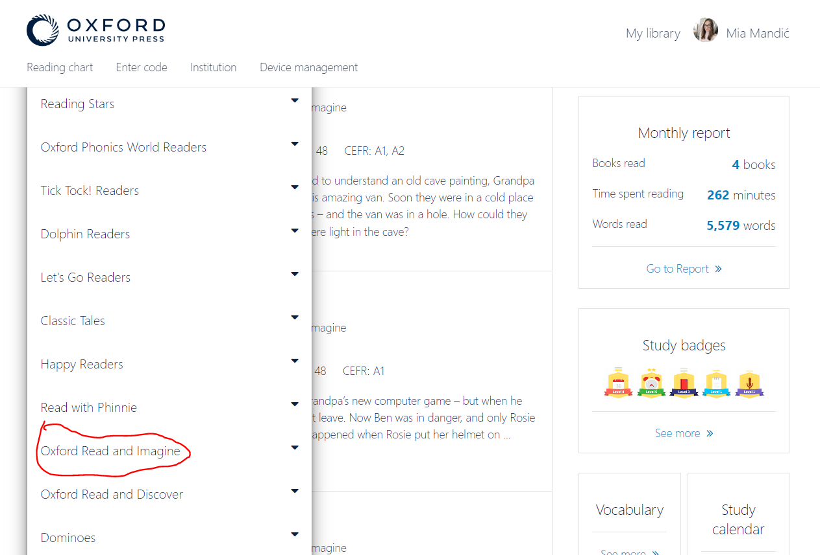
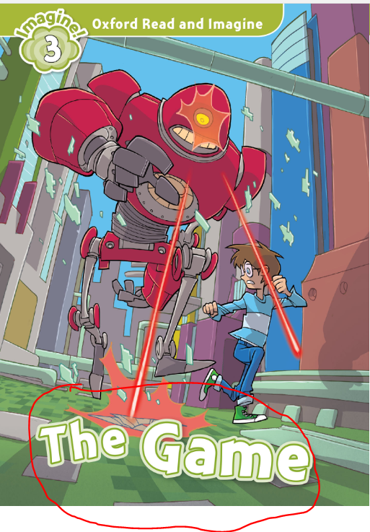
Look and guess!
In pairs, small groups or as an entire class, look at the photo and discuss the following questions:
1) Who and what can you see on the cover?
2) Where are they?
3) What are they doing?
4) What do you think the title of the story is? Write down your idea(s).
Try to find this e-book in Oxford Reading Club in the collection Read and Imagine.
Use and circle it.

Slide 6
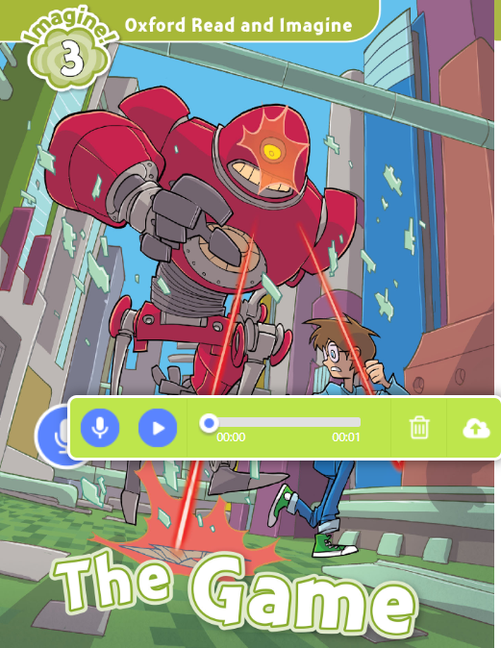
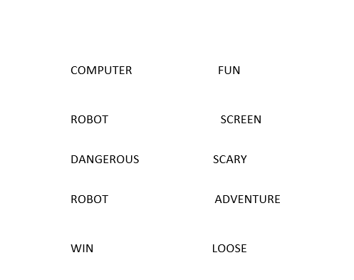
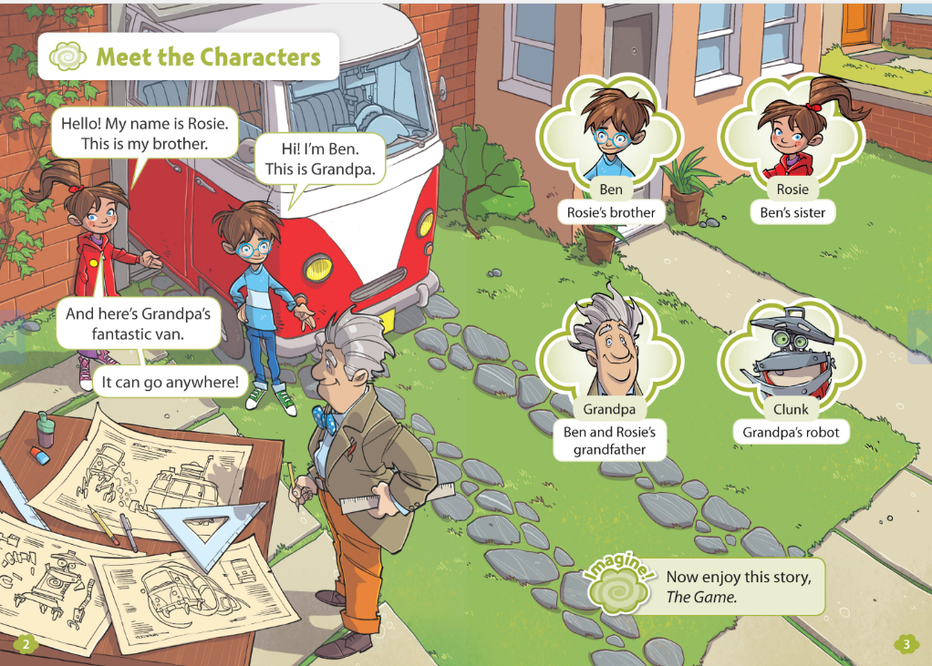
Take a closer look
What do you think the story is about? Discuss in groups and record your prediction at the cover page.
On a piece of paper, write down 5-10 words that might appear in the story. Comment your list with other students.
Open pages 2 & 3 and meet the characters.
Answer the following questions:
How are the characters related?
What are Ben and Rosie?
How old are they?
Who is Clunk?
Whose is the red van?
What does Grandpa do? (...)

Slide 7
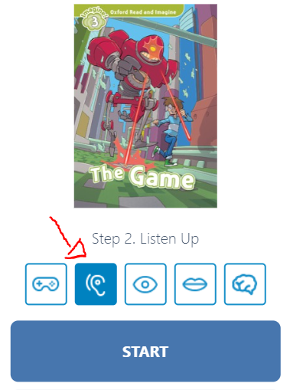
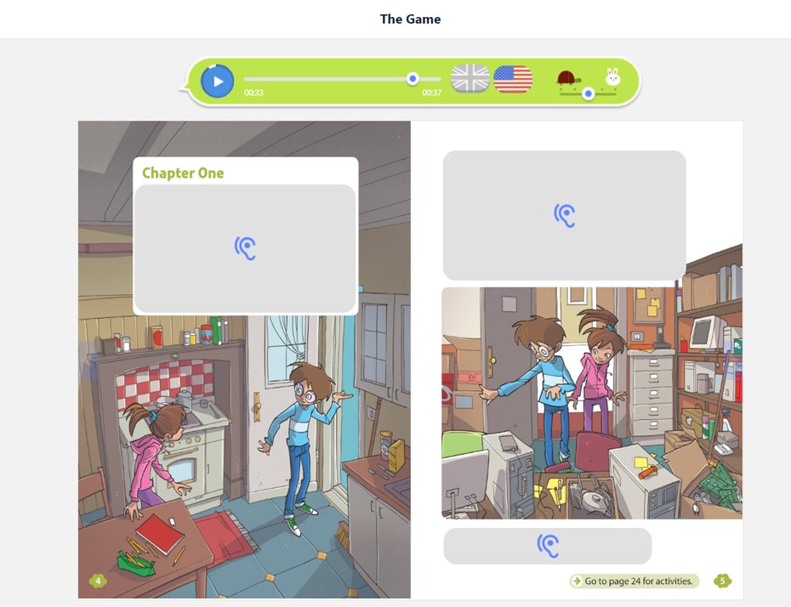
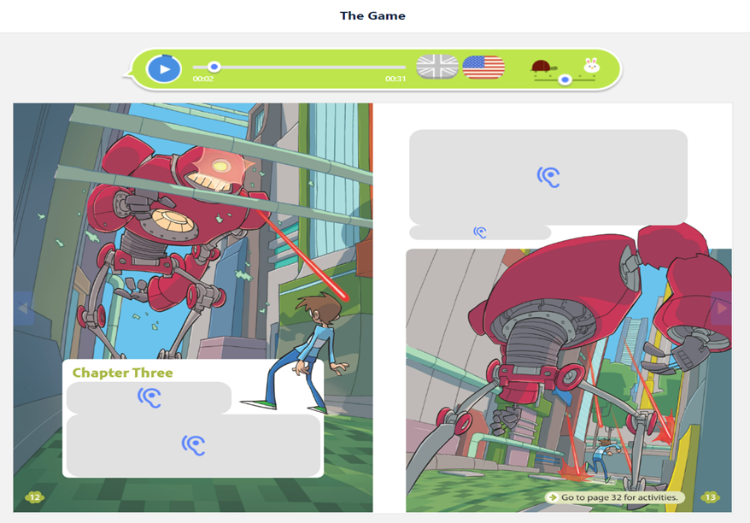
Listen carefully and answer the question:
Listen to pages 4 & 5 and answer these questions:
Where is Ben going?
What does he want to try out?
Were Grandpa and Clunk in the office?
What did Rosie and Ben see?
Listen to pages 12 & 13 and answer these questions:
Where is Ben now?
What does he see?
What is the robot doing?
What does Ben want?

Slide 8
Fill in the gap in the story!
What happened between Sam’s entering his Grandpa's office and being attacked by a huge robot?
Look at the word rose and give your predictions.
Discuss with other students.
helmet
notebook
big metal foot
angry robots
loud sound
the boy on a computer screen
tall buildings
players

Slide 9
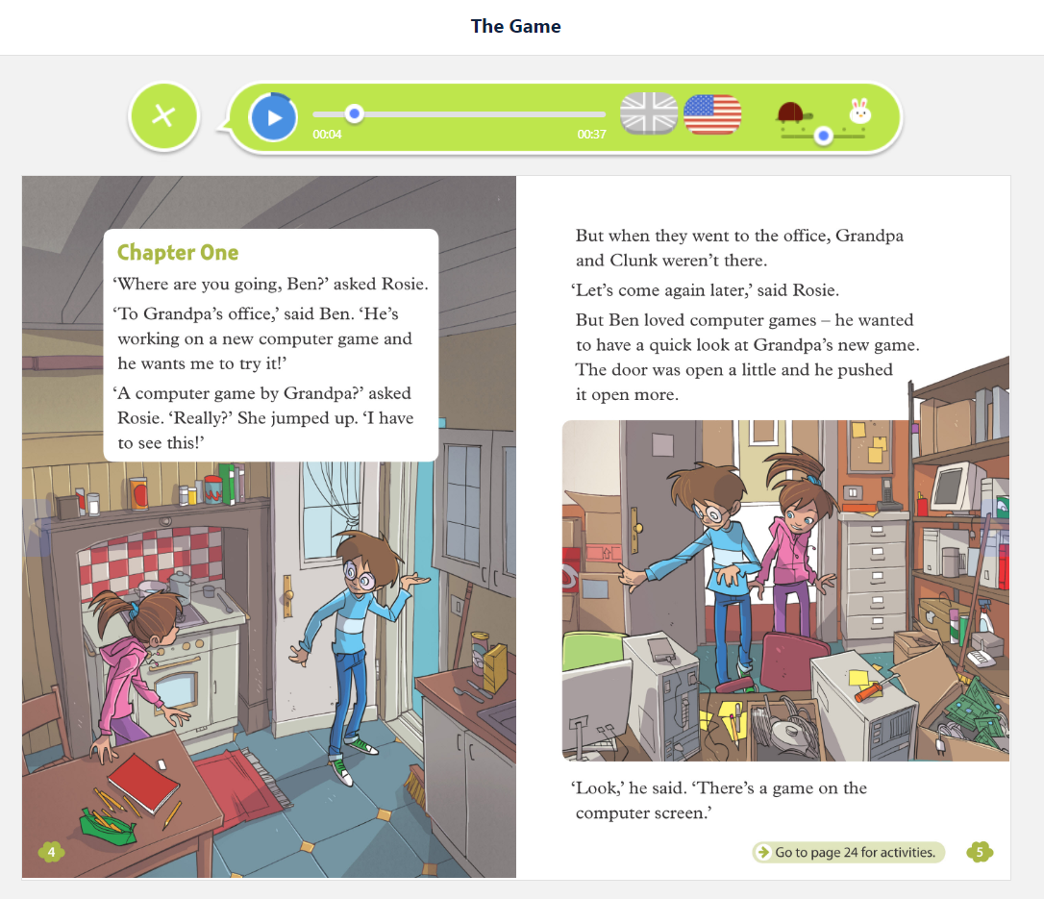
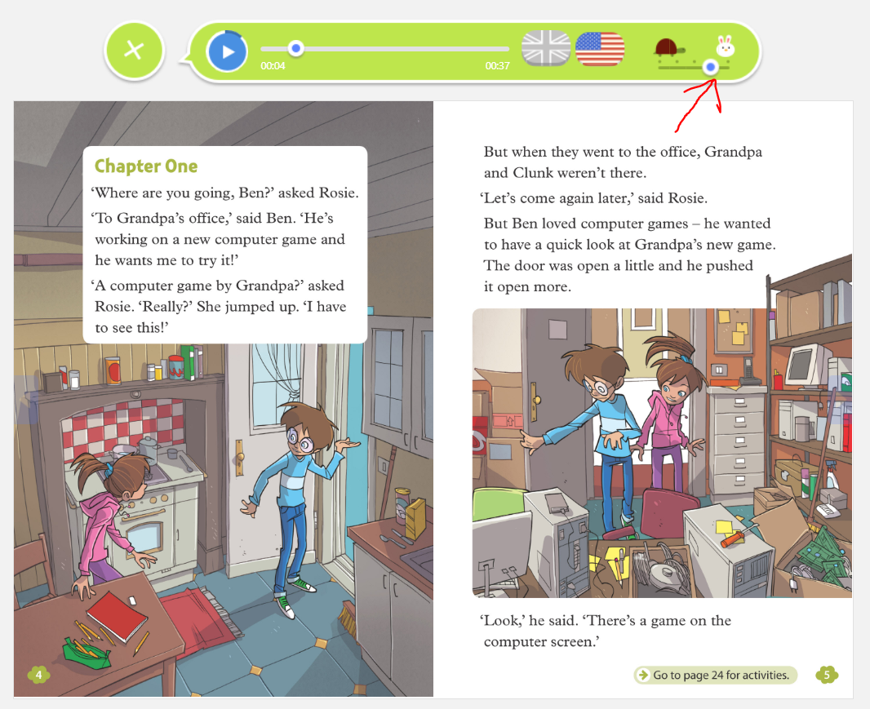
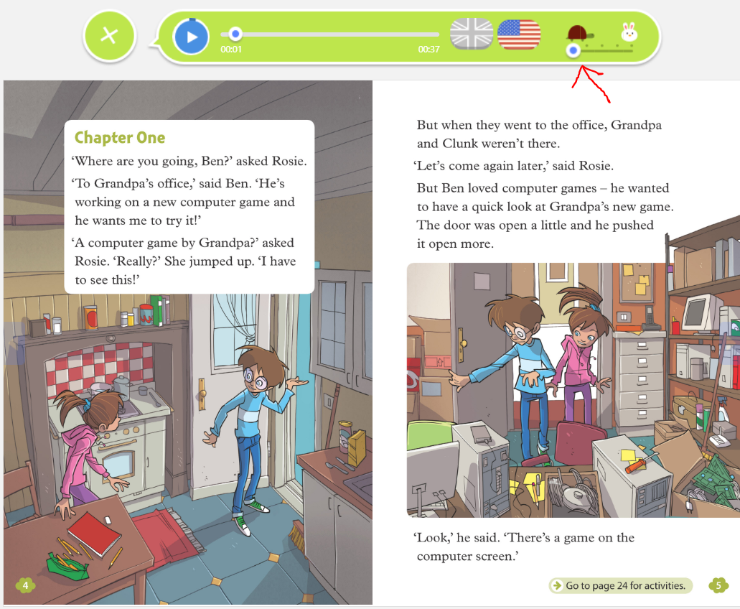
Listen and read
1) Open to Chapter One (pages 4&5), listen and read carefully.
When the audio stops, finish the sentence. Try to imitate the voice. ☺
2) Listen to and read these pages again. This time, lets try to speed up the audio.
Try to read along out loud.
Can you keep up the pace? ☺
3) Now, let’s slow down the audio speed.
Listen and read slowly, like robots.
Do you like it? ☺

Slide 10
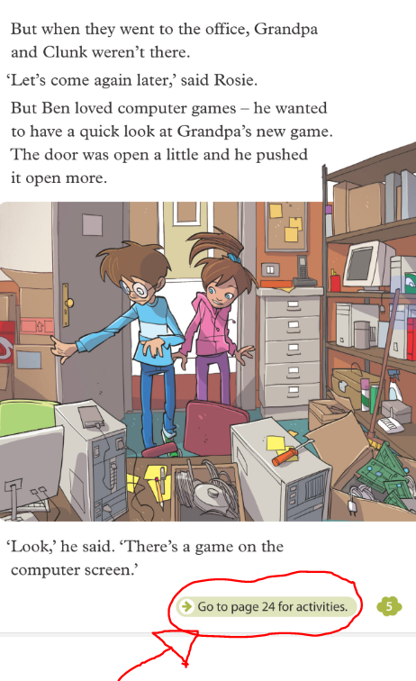
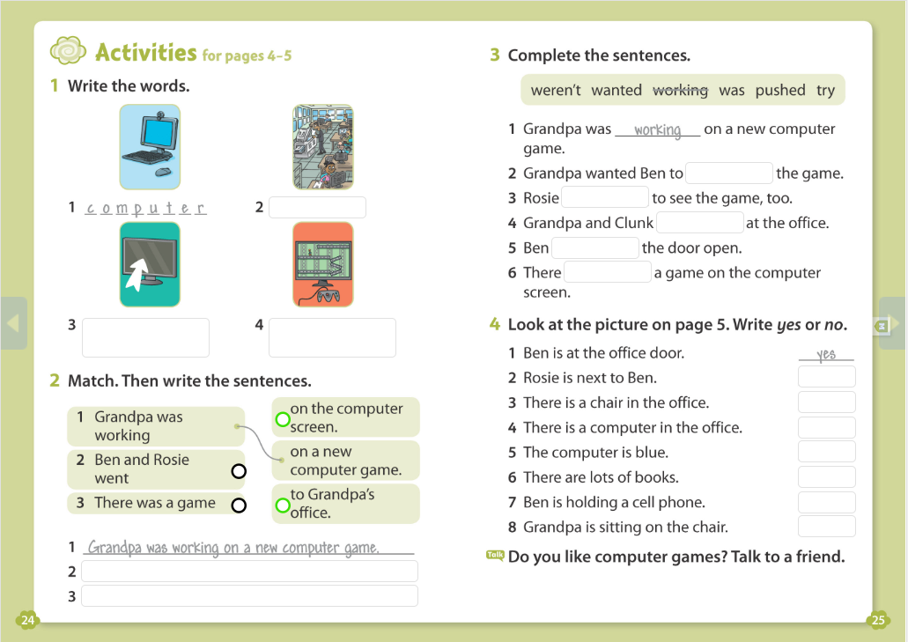
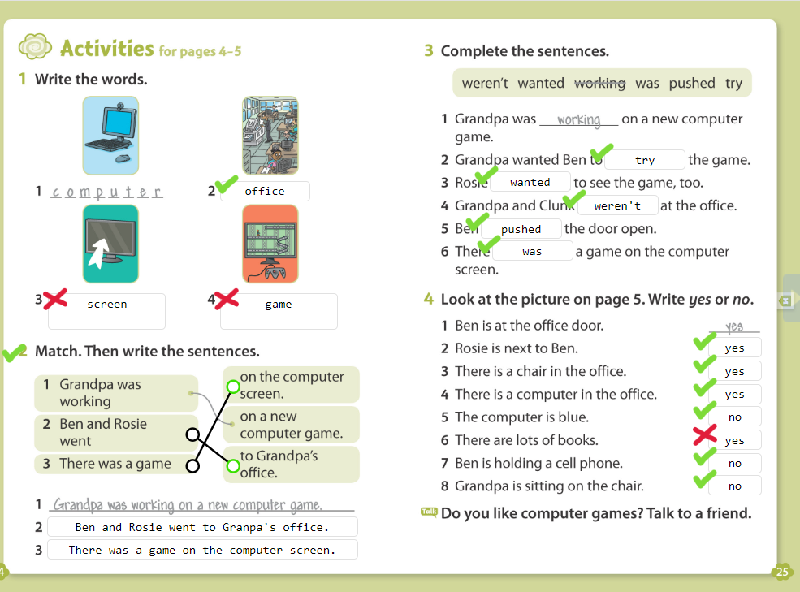
Do the activities
At the bottom of page 5 click
Do the activities individually or in pairs/groups.
When you are finished click this icon and check your answers.

Slide 11
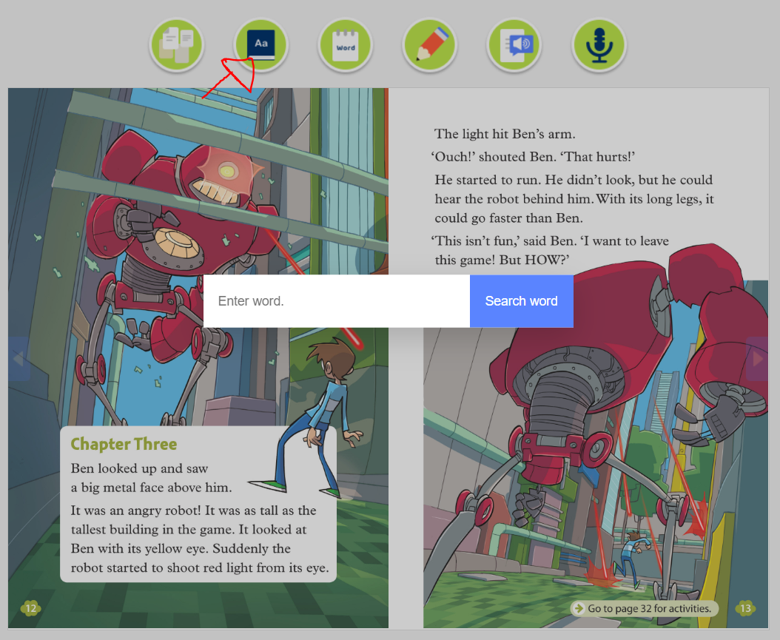
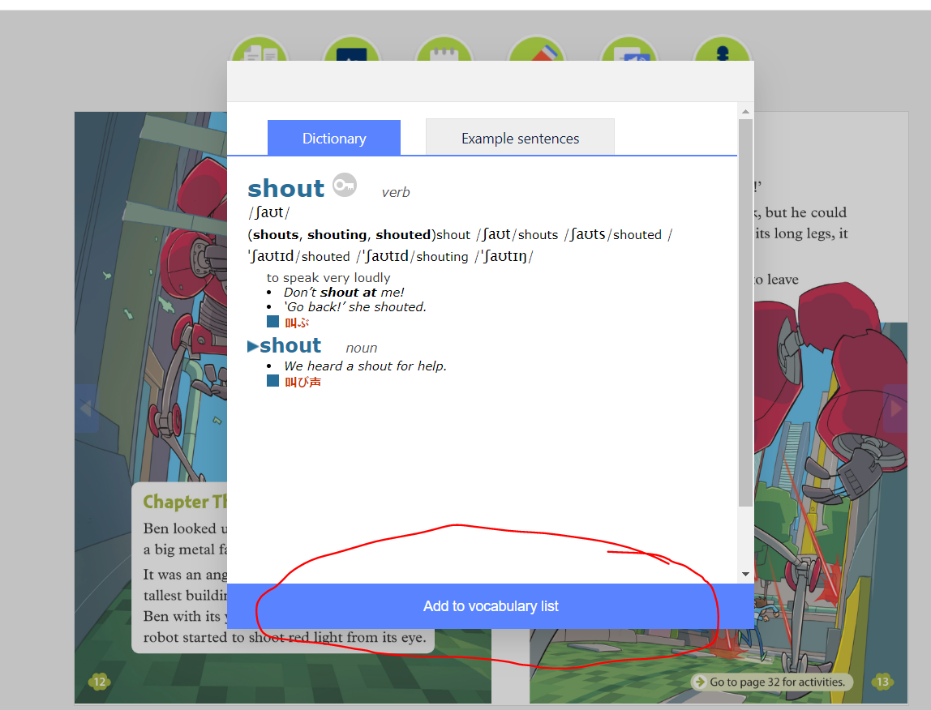
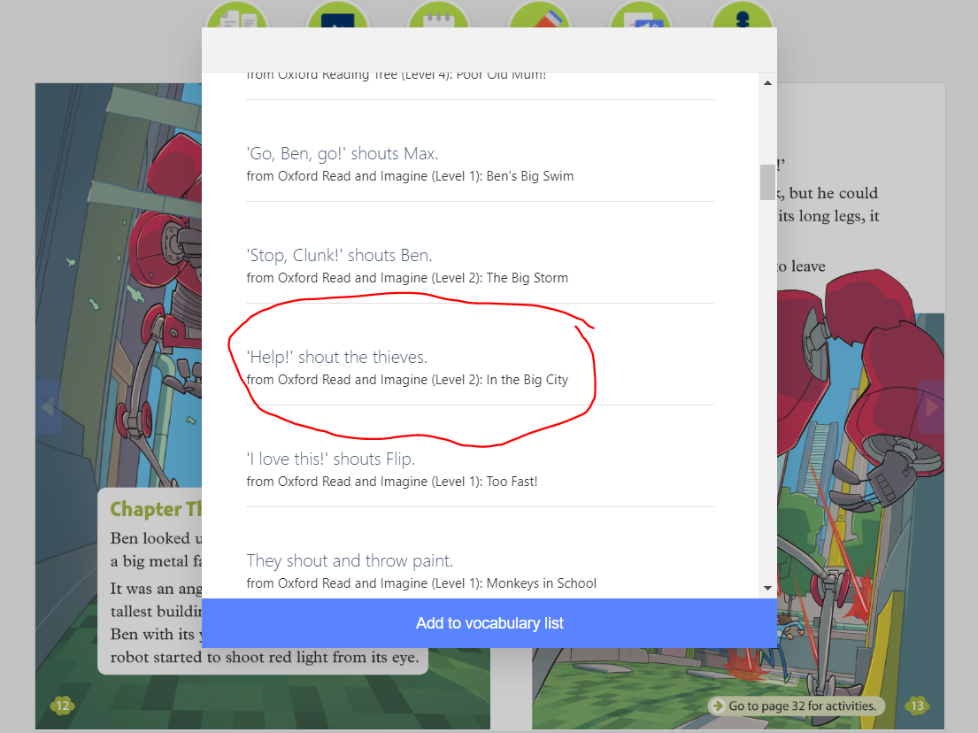
Make your own word list
Open Chapter 3 (pages 12 & 13)
Use Dictionary to find the meaning and add the following words to your vocabulary:
shout
light
angry
suddenly
shoot
Copy the example sentences from the dictionary but don’t write the main word.
For example: ‘Help!’ ________ the thieves.
Read out loud your sentences for others to guess the missing word.

Slide 12
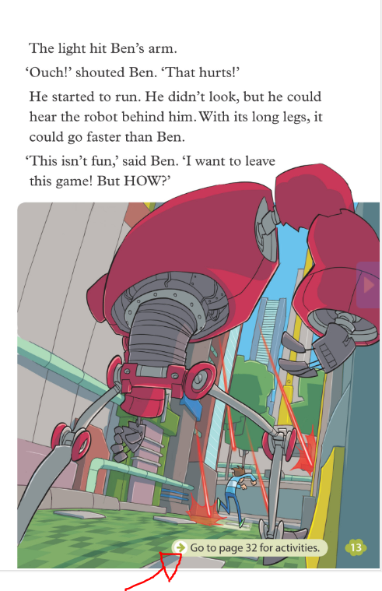
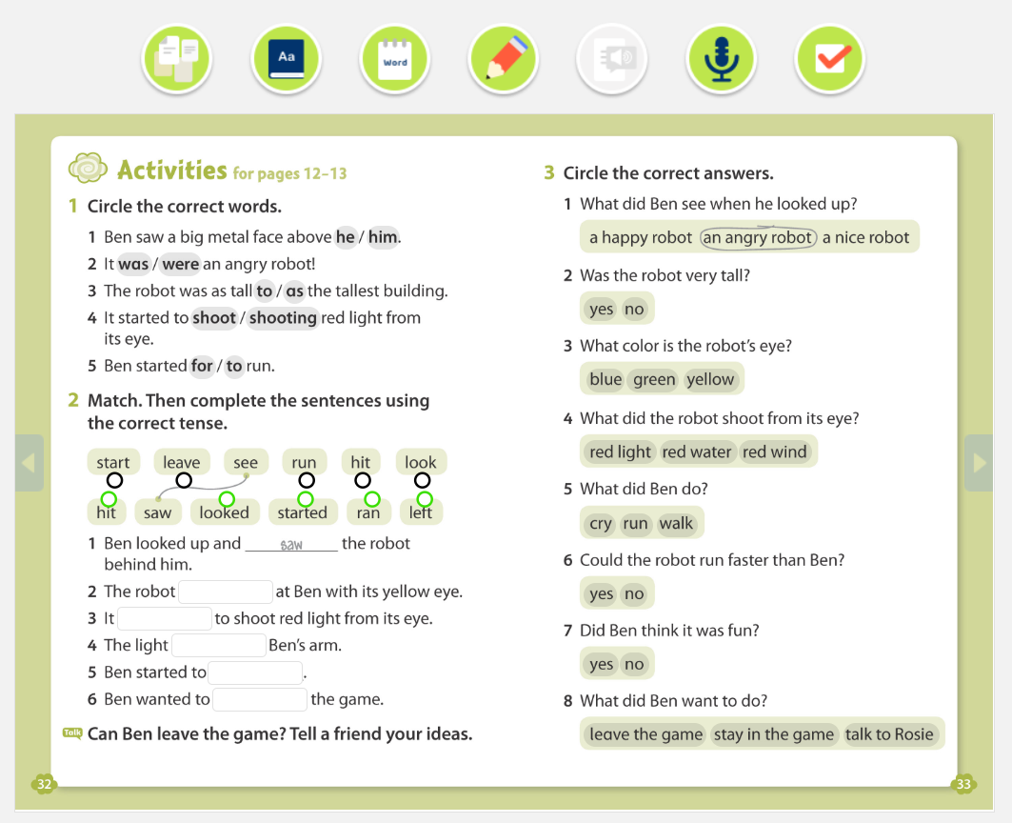
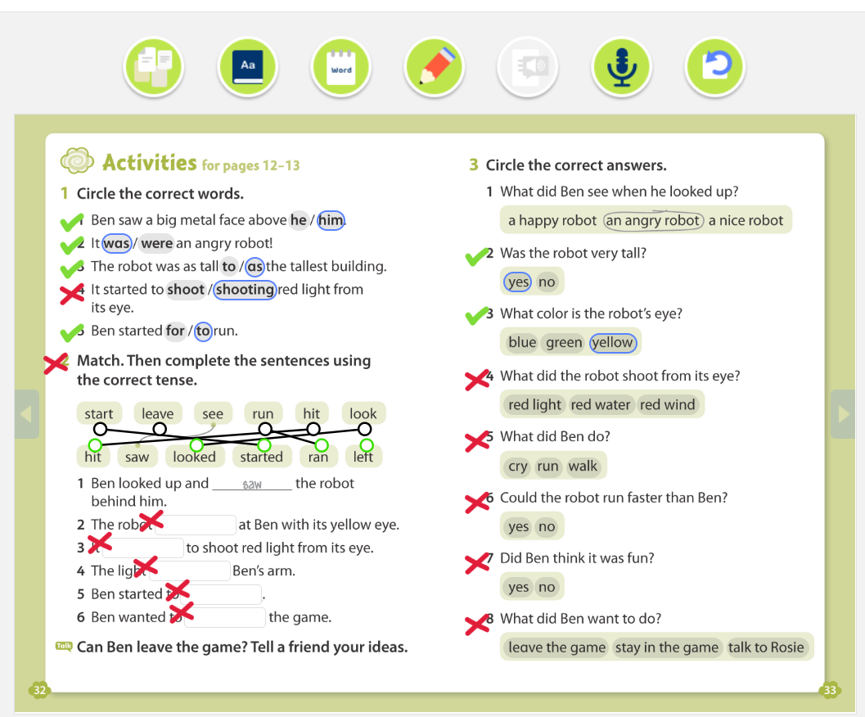
Activity time
At the bottom of page 13 click
Individually or in pairs/groups do the activities.
When you are finished click this icon and check your answers.

Slide 13
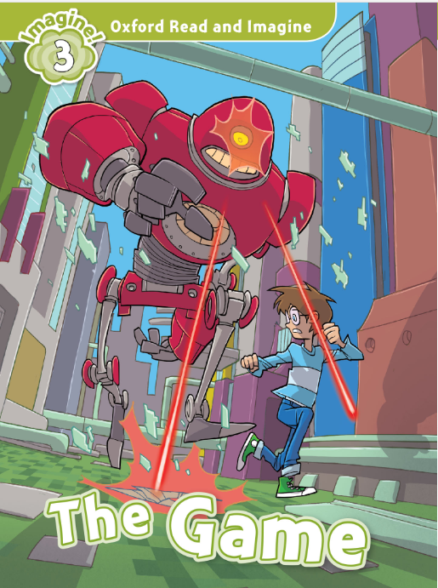
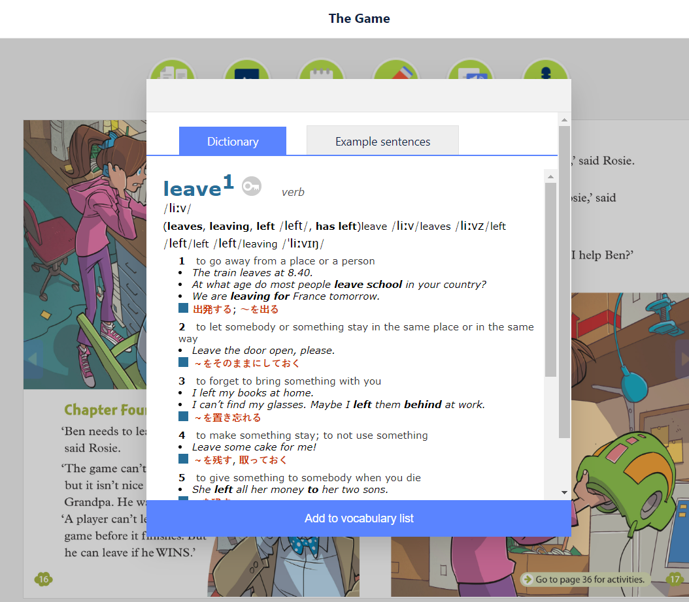
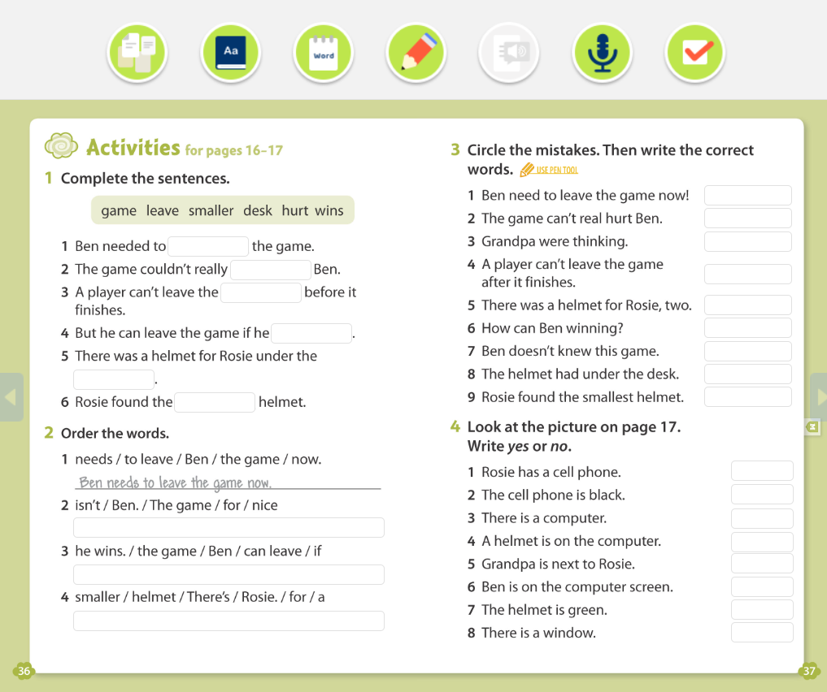
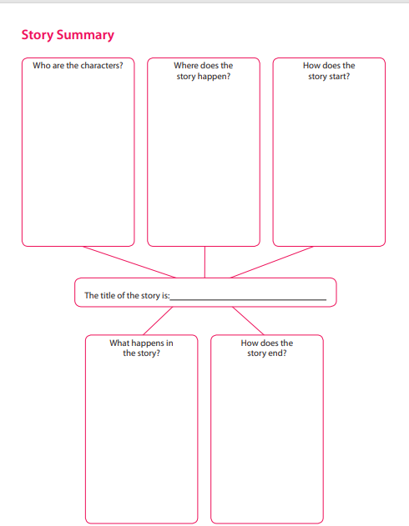
Finish your reader at home. Anywhere, anytime.
Read the whole story to find out what really happened
Find the meaning of any unknown words
and add them to your vocabulary.
Do the exercises
After you have read the story, write the story summary.
Use the worksheet and bring it to the next class of your reading club.

Slide 14
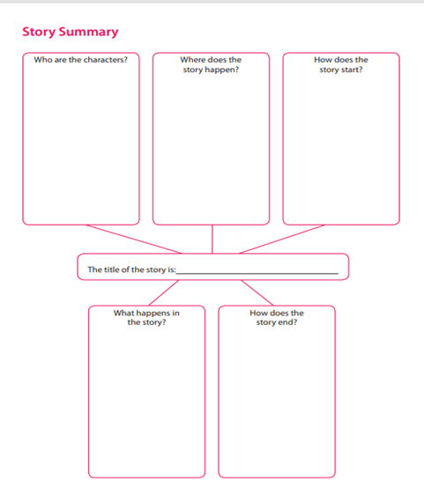
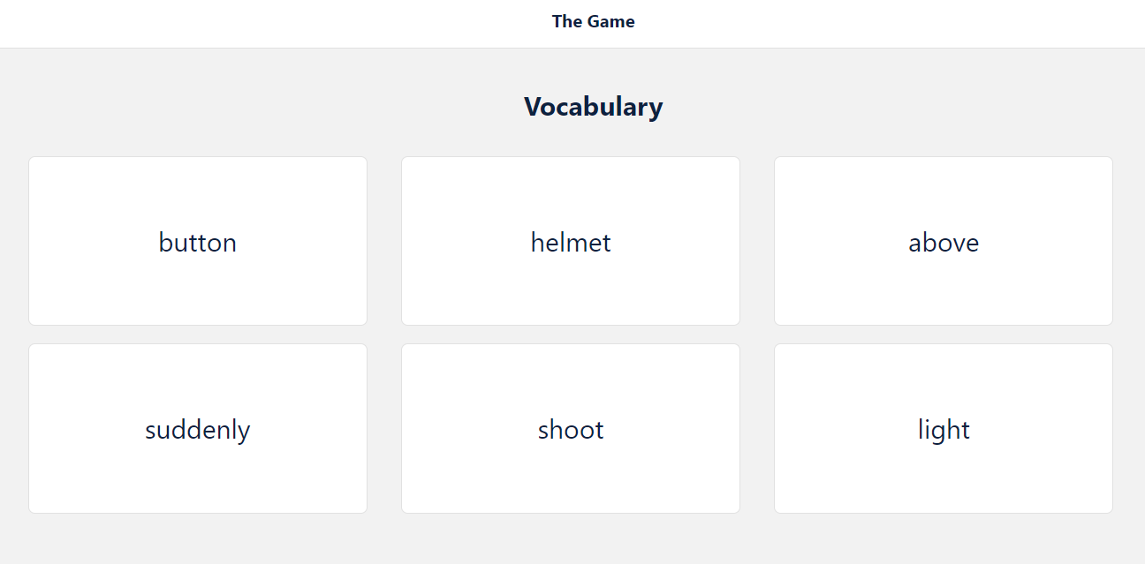
Introductory discussion
In pairs, small groups or as a class discuss what you read at home:
play your prediction notes from the front page to see how good you were in predicting
retell the story- use your Story Summary worksheet to remind yourself of the plot
Go through your vocabulary list and ask your classmate: ‘Do you know what the word ______means?”
Would you recommend your book? Why yes/no?

Slide 15
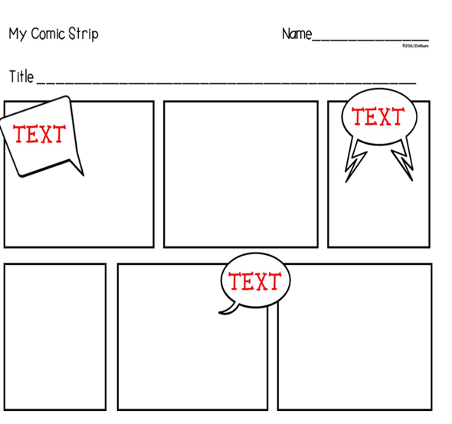
Choose your project task
It’s time to be creative and do your project work. ☺
You can choose between these 3 ideas:
Think of a new computer game and write about it
Create your own version of this story
3) Make a comic version of the story The Game
Find more about all three options on the next few slides.
Notes:
Photo credit: https://www.papertraildesign.com/comic-strip-template-pages/
15

Slide 16
Create a new computer game
Open your e-book to pages 44 & 45.
Individually do exercise 1- complete the chart with the words from the box.
Do the following activities in pairs/groups:
compare your answers and discuss the questions from exercise 1:
Do you play computer games? What games do you like?
think of a new computer game and make notes in exercise 2
write a short description of your new game (200 words)

Slide 17
Create your own version of the story
In pairs or small groups write a new version of the story.
Discuss the following questions:
Who are the characters? (Maybe you and your school friends.)
Where does the story happen? (In your school or in a scary house?)
What game are you in and how did you get there?
What happens in the story? Who do you meet in the game?
What vocabulary will you be using? Write down some key words.
How does the story end?
Notes:
Photo credit: https://school-education.ec.europa.eu/en/etwinning
17

Slide 18
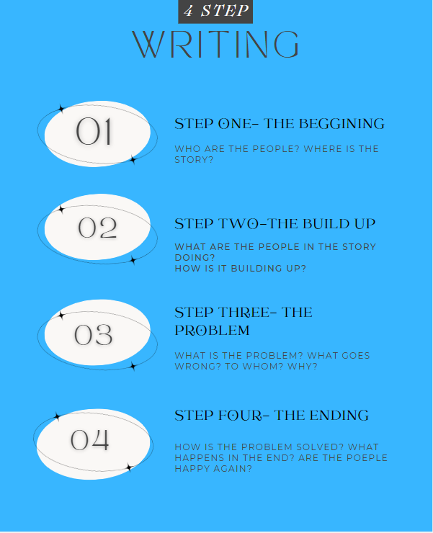
Create your own version of the story
Start writing your story:
Use the worksheet 4 STEP WRITING to help you organize the story.
Read it out loud a few times
Edit and revise (pay attention to the language- spelling and grammar)
Add illustrations/drawings (optional)
Ask for feedback
Notes:
Photo credit: https://en.islcollective.com/english-esl-worksheets/skill/reading/story-mountain-planner/78990
18

Slide 19
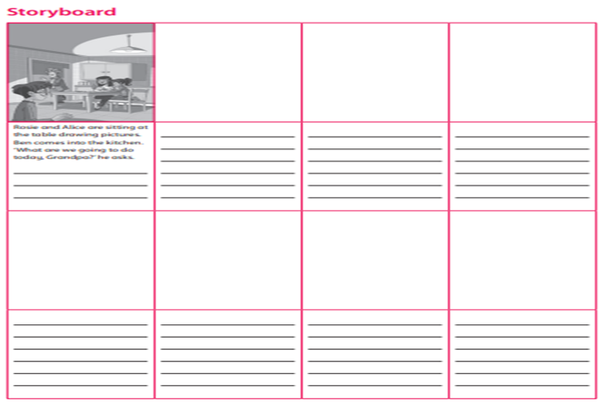
Create your comic strip
Follow these 4 steps to create a comic:
Write down the ideas for your comic:
Who are the characters?
What are they doing?
Where is the story?
What goes wrong?
How is the problem solved? (...)
make sure each part has some action and that your ending is powerful
Use the worksheets 4 Step Writingor Storyboard to help you organize your comic and make notes (optional)

Slide 20
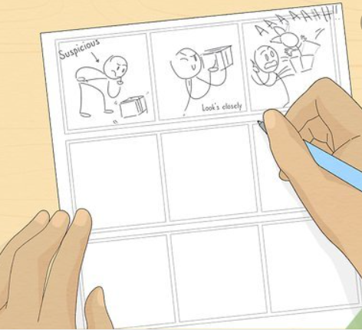
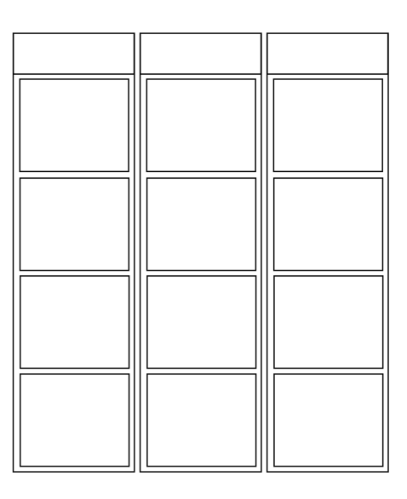
Create your comic strip
2) Draw your comic frames or use the template
Find and download different comic frames here
3) Draw out your characters:
you can use basic shapes- watch the video to get more ideas
lightly outline speech bubbles and starburst for sound effects
use pencils so you can erase any mistakes
Notes:
Video credit: https://www.youtube.com/watch?v=1Nb_ZDvoWEg
20

Slide 21
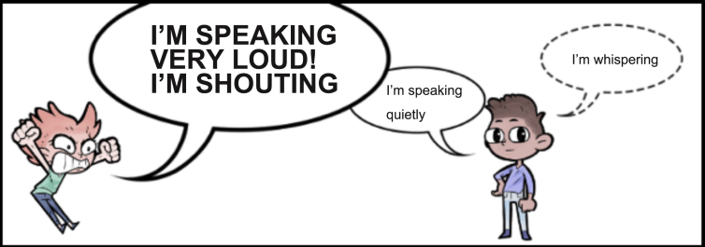
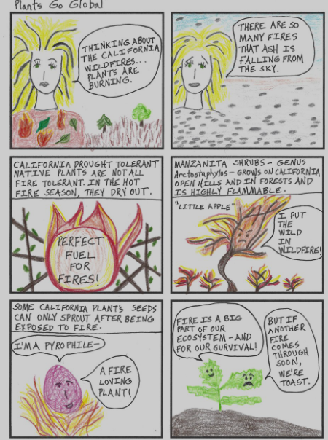
Create your comic strip
4) Add in your speech into the speech bubbles:
the size of your letters could show if a character is shouting or whispering
check your spelling and grammar
5) Add details:
draw in the background
add extra details to your characters, such as facial expressions, movement lines(...)
go over your comic in pen
color your comic or make it black &white by shadowing (optional)
Notes:
Photos credits:
https://bdnf.bnf.fr/EN/fiches/8.%20Speech%20Bubbles.pdf
https://belajarpenerjemahan.files.wordpress.com/2012/09/lose-loose.jpg
https://plantsgoglobal.com/comics
21

Slide 22
Create your comic strip in Canva
Register to a free-to-use online graphic design tool:
https://www.canva.com/
How to register:
https://www.tutorialspoint.com/how-to- create-a-new-canva-account
Decide on the content of your comic
Explore how to make comics in Canva:
How to Create & Publish Comics With Canva - YouTube
Create your comic
Display, download, share or print your comic! ☺
Notes:
Video credit: How to Create & Publish Comics With Canva - YouTube
22

Slide 23
Display your artwork
In small groups, display and comment your project work.
Tell the rest of the class about your new game, read a new version of the story or show your comic strip.
Choose the most interesting one. ☺
Notes:
Photos credits:
https://www.teachingexpertise.com/classroom-ideas/activities-for-middle-school/
https://www.teacherspayteachers.com/Browse/Search:positive%20peer%20feedback/
23

Slide 24
Notes:
Photo credit: https://www.vecteezy.com/vector-art/1220888-the-world-belongs-to-those-who-read-quote
24

