Slide 2
WORKSHOP: I did it my way ☺
After reading all different kinds of books in the school project, you have now become an expert in reading. Congratulations! ☺
Form small groups and discuss the following question:
What have your read so for?
Which e-book(s) do you like best? Why?
What genres do you find most
interesting? Why?
What was your favourite activity in the workshops? Why?
Notes:
https://www.dreamstime.com/overhead-shot-high-school-pupils-using-digital-tablets-group-study-around-tables-overhead-shot-high-school-pupils-using-image126999389
2

Slide 3
Now, you choose.
Choose an e-book that you would like to read.
You can choose between different reading collections and levels.
Quickly skim and scan through the book, read the summary and chapter titles, explore the characters (...)
Notes:
Photo credit: https://iristech.co/why-reading-e-books-is-good/
3

Slide 4
Group discussion:
In your groups talk about the books that you have chosen.
You can use these questions:
What is the title of the book?
Who wrote it?
Do you know anything about the author? Is he/she famous?
Why did you choose the book?
What genre is it?
What is it about?
Who is the main character? (...)
Notes:
Picture credit: https://www.dreamstime.com/overhead-shot-high-school-pupils-using-digital-tablets-group-study-around-tables-overhead-shot-high-school-pupils-using-image126999389
4

Slide 5
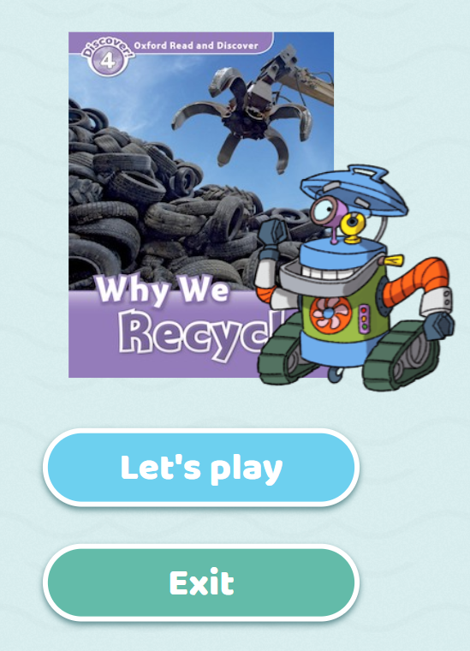
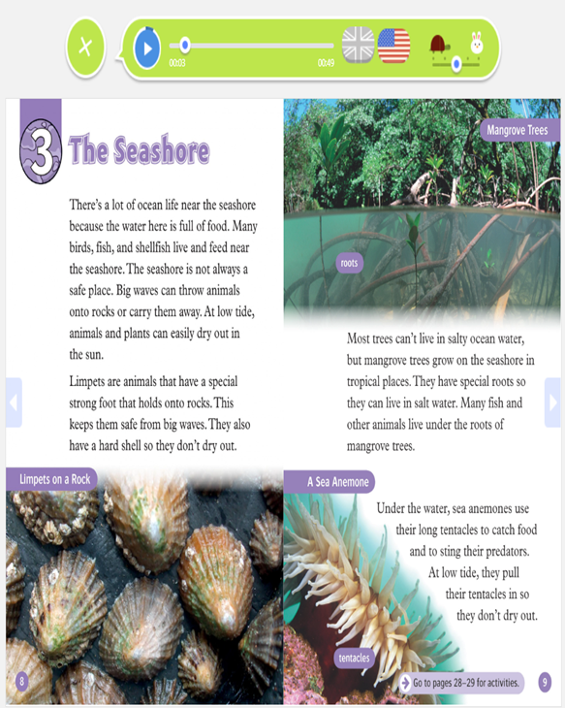
reading:
Do the warm up activity ( optional)
Read as much as time allows:
You can read and listen
Use earphones if necessary
Determine pace and dialect

Slide 6
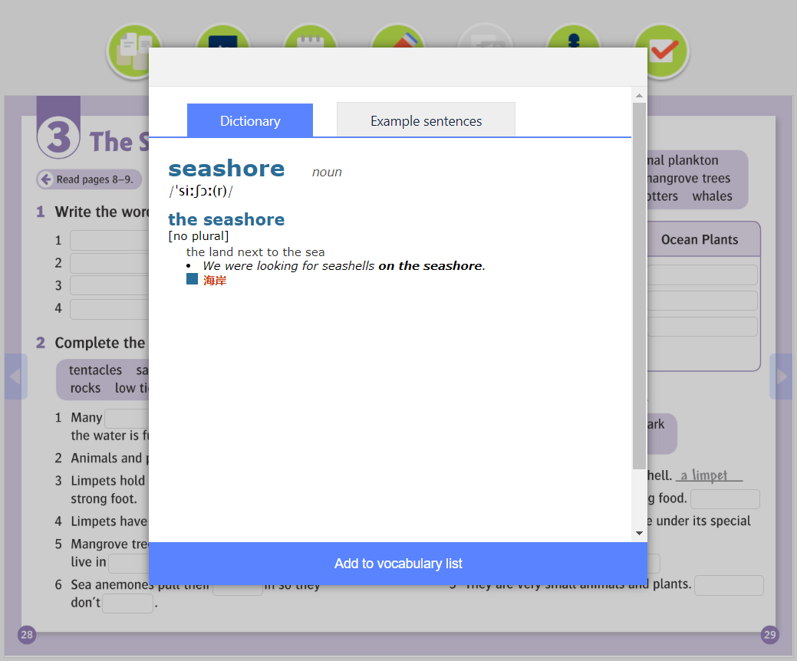
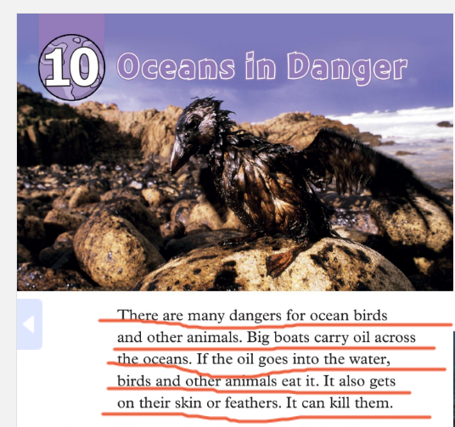
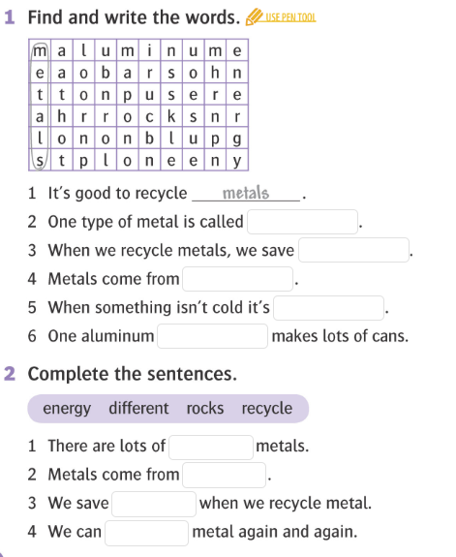
While-reading activities:
Find the meaning of any unknown words (dictionary) and add them to your vocabulary.
Underline the most interesting parts, facts, scenes, descriptions(...)
Optional:
After each chapter, do the exercises (reading comprehension, vocabulary and grammar)

Slide 7
After-reading activities:
In your groups discuss what you have just read.
You can use these example questions:
What is your reader about?
Do you like it?
What have you underlined and why?
Are there a lot of unknown words?
Do you have troubles with language? (...)
Notes:
https://www.schooloutfitters.com/blog/3-questions-to-ask-when-planning-your-21st-century-learning-environment
7

Slide 8
Finish your e-book at home. Anywhere, anytime.
Your tasks while reading at home:
1. Think of the way you will be presenting your e-book in the next workshop.
To get more ideas, go through the next few slides.
2. Prepare and rehearsal your presentation out loud.
Maybe you can practice with a friend or in front of a mirrror.
Remember that you only have 10- 15 minutes to introduce your book.
3. The most important task for you is to ENJOY your reading. ☺
Notes:
Photo credit: https://www.inikalteng.com/5-tips-untuk-menjadi-percaya-diri/
8

Slide 9
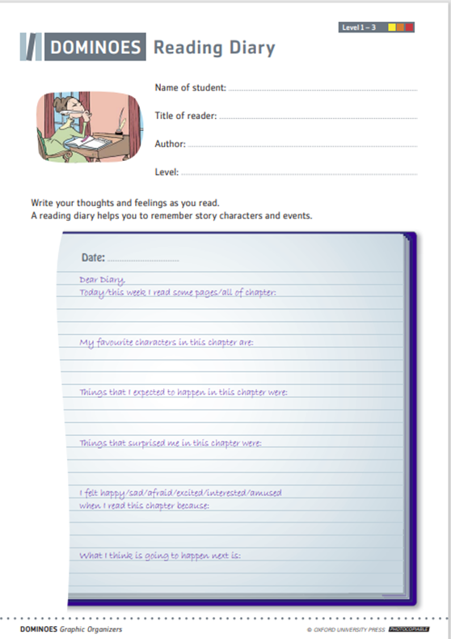
Ideas for your presentations: Reading Diary
Write your thoughts and feelings as you read just as if you were writing a diary.
You can use the worksheet Reading Diary to help you organize your writing.
Another version:
Place yourself in the shoes of one of the characters you have just read about and write a diary as if you were he/she. Share their thoughts and fears.

Slide 10
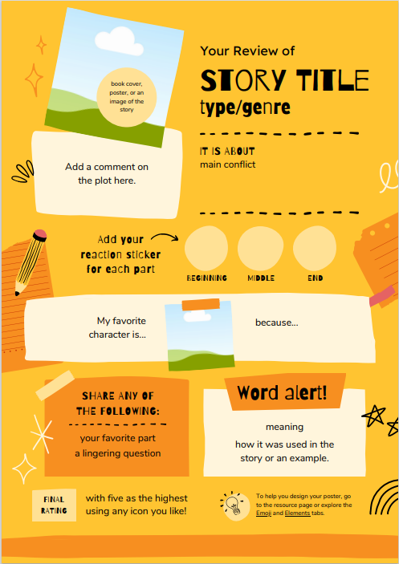
Ideas for your presentations: Book Review
Write a short review of your book.
You can use the Book Review Templates or include the following:
How would you rate the book? (0- I didn’t like it./ 5-Loved it!)
Would you recommend it to your friends? Why?
What was your favourite part of the book/character?
Is there anything you would change?
Notes:
Photos credit: https://www.teacherspayteachers.com/Product/Book-Review-Template-FREE-3095993
10

Slide 11
Ideas for your presentations: PowerPoint
Decide on how you want to organize your presentation. What is the content of your presentation?
Give a few information about the author
Talk about the genre of the book
Give a short summary
Describe the main characters/events/facts from your book
Comment on your favourite part/character
Give your opinion on the book
Add pictures/videos/music (...)

Slide 12
Ideas for your presentations: PowerPoint
Watch a short video on how to make a PowerPoint Presentation
4) Write your presentation
Decide how to organize your content on the slides (What will you put on each slide?)
Add photos/videos (...)
Notes:
Video credit: https://www.youtube.com/watch?v=cfhnW3bd064
12

Slide 13
Ideas for your presentations: Create a comercial
You are a selling agent trying to sell out the book:
Who is it for?
How much does it cost?
When is it available?
What are 3 reasons people should buy it?
What is your slogan?
Write down or record your comercial.
Notes:
Photo credit: https://en.islcollective.com/english-esl-worksheets/vocabulary/advertisingmarketing/create-commercial/117475
13

Slide 14
Ideas for your presentations: Find a song
What song(s) would acommpany different parts of your book if you were making a movie?
Would it be pop music, hip hop, rock, funk, blues, classic(...)? Why?
Play the song(s) and explain.
Another idea:
Find as many pieces as you can of music inspired by the book you are reading.
For example, Metallica’s song- Some Kind of a Monster was inspired by the secret life of Victor Frankenstein.
Present one of pieces of music to your classmates and explain whether you like it or not, and why.
Notes:
Video credit: https://www.youtube.com/watch?v=NxSgYehng1k
14

Slide 15
Ideas for your presentations: Draw
Draw a passage from a novel or a short story.
Close your eyes and listen to the passage a number of times to see in your mind’s eye what is happening in the story.
Draw the scene as you have imagined it.
Explain what you draw and why.
Notes:
https://www.dreamstime.com/photos-images/holding-sketchbook.html
15

Slide 16
Workshop time! Introductory discussion
In pairs, small groups or as a class discuss what you read at home:
What’s the title of the book?
What is it about?
What genre is it?
What is the most interesting part, why?
Were there many unknown words?
Would you recommend it? Why yes/no?
Notes:
https://www.psychiatryadvisor.com/home/topics/anxiety/group-cognitive-behavioral-therapy-is-effective-treatment-for-adolescent-anxiety/
16

Slide 17
Presentation time
Introduce your book to your classmates.
Speak clearly and loudly, don’t rush. ☺
While you are presenting, other students make notes and write their questions/comments.
Everyone needs to have at least one comment or question.
Take a look at the photo- Speech Bubbles Display to get an idea on how to comment.
Use positive language and be polite. ☺
Notes:
Photo credit: https://www.teacherspayteachers.com/Browse/Search:positive%20peer%20feedback/
17

Slide 18
Notes:
Photo credit: https://www.teacherspayteachers.com/Browse/Search:positive%20peer%20feedback/
18

