Slide 2
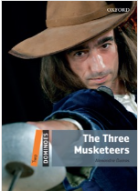
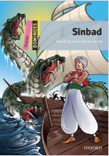
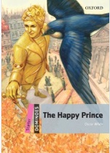
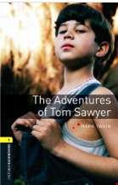
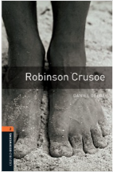
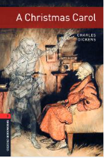
WORKSHOP: Make Your Own Board Games

Slide 3
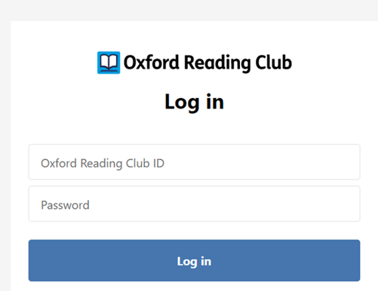
Let’s get started!
Click here and log in to Oxford Reading Club by using your ID and password :

Slide 4
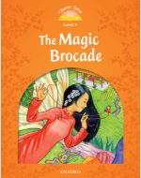
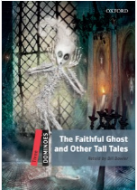
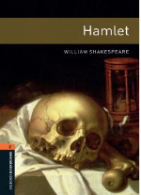
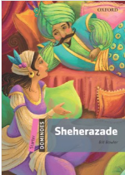
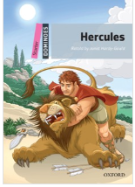
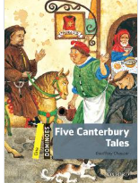
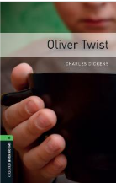
What can we discover by reading?
Quickly skim and scan Oxford Reading Club and write at least three titles in the correct column:
Compare your answers with your classmates.
Tales: | Story Collections | World Literature

Slide 5
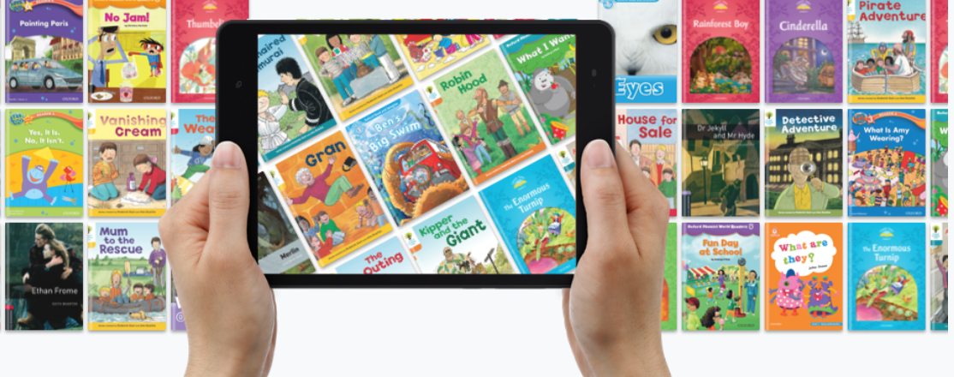
Read your way to better English!
Choose an e-book that belongs to tales, story collections or world literature from Classical Tales, Dominoes or Bookworms Collections that you would like to read.
For now, don’t tell it to anyone. ☺

Slide 6
Pre-reading activities:Time to mime!
Have you ever tried to tell a story without
words through your facial expressions and
body movements? How is this art called?
Mime or pantomime! That’s right. ☺
Watch these YouTube videos and try
pantomime yourselves by imitating
the characters from the videos.
Now, in pairs or small groups try to mime
your book’s title? Did they guess it? ☺
Notes:
Videos credits: https://www.youtube.com/watch?v=A48JDnW5X9g
https://www.youtube.com/watch?v=bWYPDGpX0sk
6

Slide 7
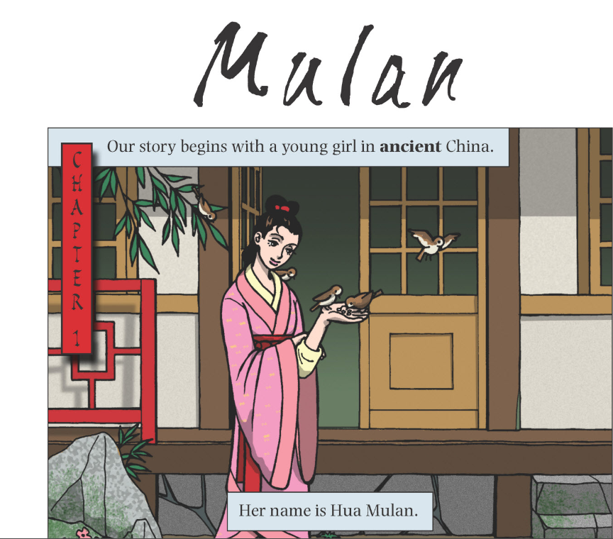
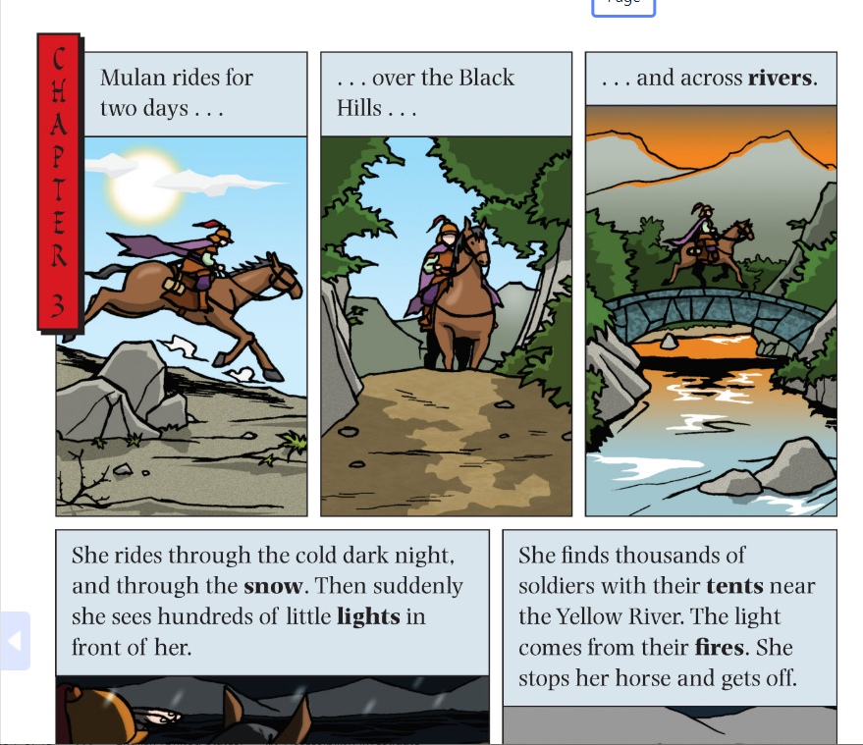
reading:
Read two chapters:
(depending on your level, you can read one or more chapters)
You can read and listen
Use earphones if necessary
Determine pace and dialect

Slide 8
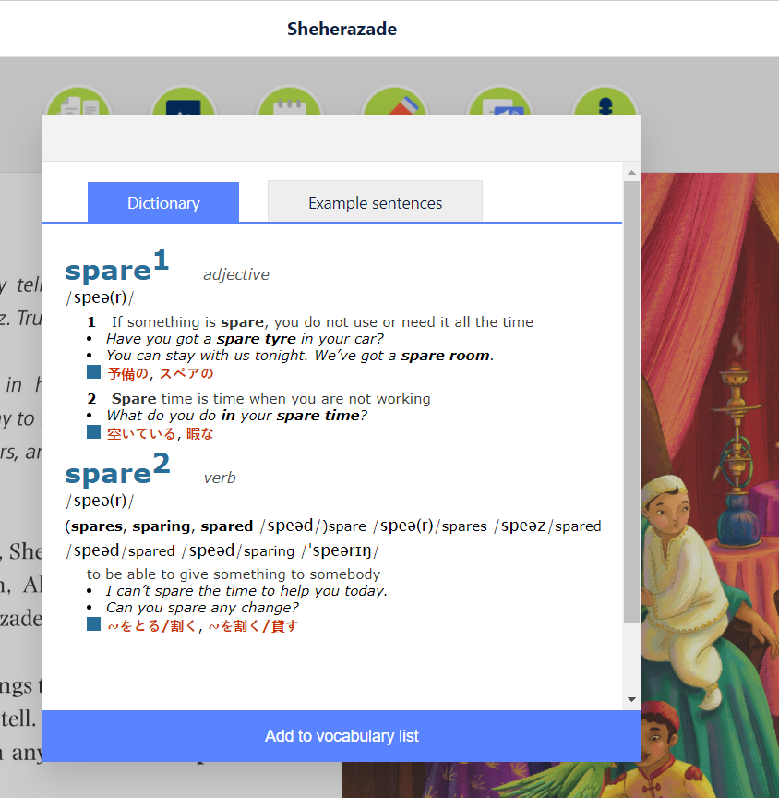
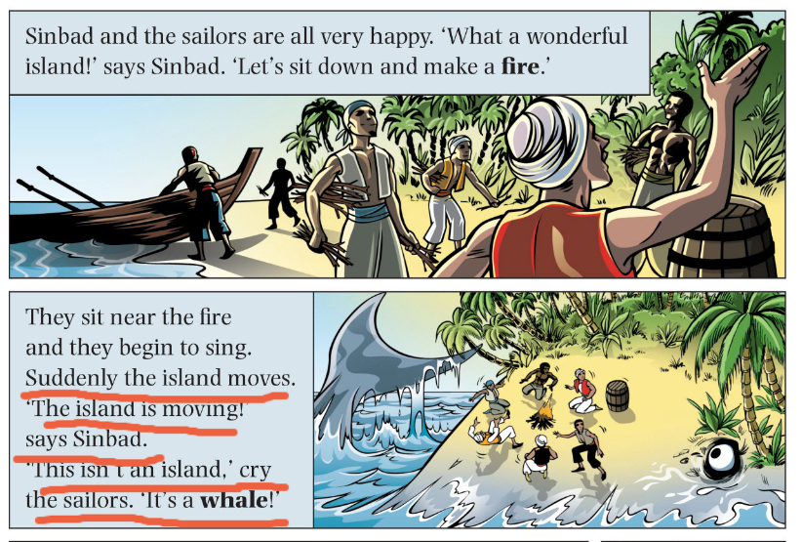
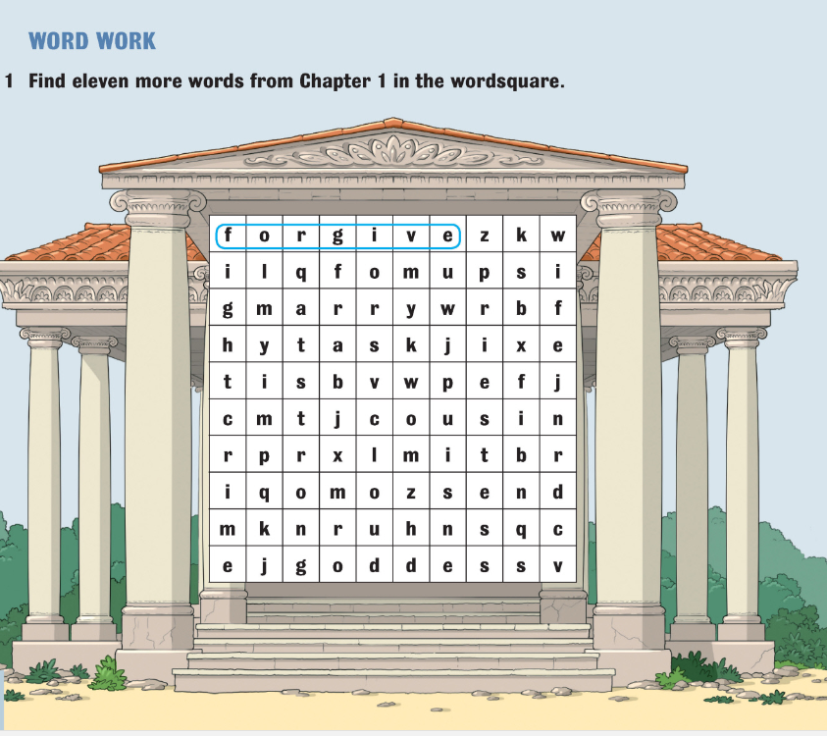
While-reading activities:
Find the meaning of any unknown words (dictionary) and add them to your vocabulary.
Underline the most important parts, facts, scenes, descriptions (...)
After each chapter, do the exercises (reading comprehension, vocabulary and grammar)

Slide 9
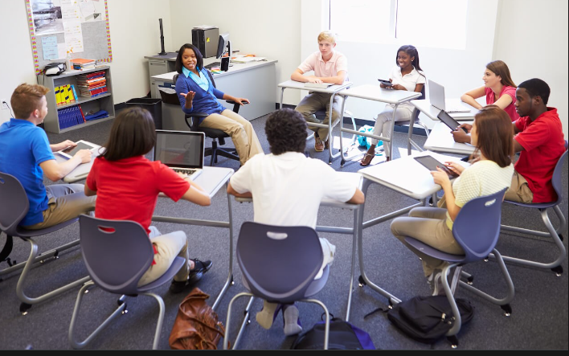
After-reading activities:
Choose one of the two group activities:
Quickly draw a sketch of a scene or a character from the chapters that you have just read and show it to the other pupils.
Do they recognize a character or a scene?
2) Find the appropriate background music or a song
for the underlined parts.
What kind of music did you choose and why? Dramatic, happy, sad? Do you have a particular song in mind? Can you find it on You Tube?
Play the song in the background and read the according lines from the e-book.
Notes:
Photo credit: https://www.cfgnh.org/articles/preventing-teen-pregnancies
9

Slide 10
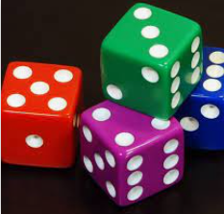
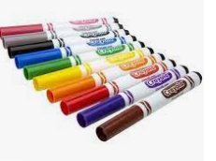
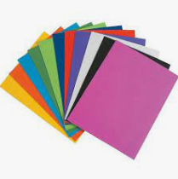
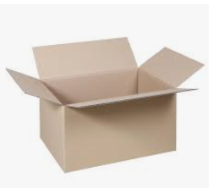
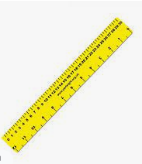
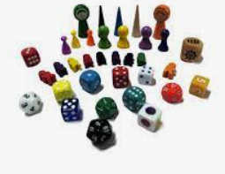
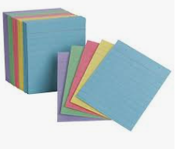
Bring for the next time:
Posterboard, cardboard or cardstock
Game tokens, such as small toys
Blank note cards or construction paper
Dice
Pencil, markers, crayons, paint and stickers
Paper
Ruler
Notes:
Photos credits:
https://en.wikipedia.org/wiki/File:6sided_dice_(cropped).jpg
https://stemk12.org/a-message-from-the-s
https://www.travisheightselementary.com/blog/2014/08/04/2014-2015-scho
https://www.kaiserkraft.hr/materijali-za-pakiranje/kartoni-kartonske-kutije/sklopiva-kartonska-kutija-fefco-0201/od-1-valnog-kartona/p/M66545/ol-supply-list/tem-administration-team-about-vandalism-and-safety-at-stem/
https://blountpartnership.com/tag/winter/?web=5.6.3331975.1.17.41.ruler+pic
https://es.made-in-china.com/co_sz-wonderful/product_Board-Game-Pieces-Token-Chips_enhrnyoyy.html
https://dmm-unik.hr/kategorija/vrtici-i-skole/papir-i-papirnati-proizvodi/paus-papir
https://www.walmart.com/ip/Pen-Gear-Unruled-Index-Cards-White-100-Count-4-x-6/815486762
10

Slide 11
Finish your reader at home. Anywhere, anytime.
Your 4 tasks at home:
Use dictionary to find all unknown words and add them to your vocabulary list
If you want, do the exercises within your e-book.
After you have read the entire e-book, it is important to write down 5-10 questions and answers based on your e-book:
How many stepsisters does Cinderella have?
Who was held captive in Jamestown?
What are the names of the creatures that Zeus trapped in Hercules? (....)
4) The most important task for you is to ENJOY your reading. ☺
Notes:
Photo credit: https://www.freepik.com/premium-photo/portrait-happy-middle-eastern-family-using-laptop-together-home-arabic-parents-their-cute-little-daughter-relaxing-with-computer-couch-living-room-watching-movies-enjoying-weekend_22279835.htm
11

Slide 12
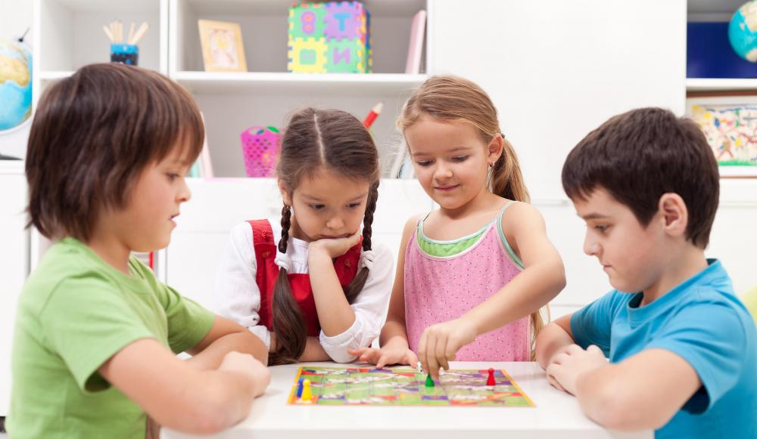
Workshop- Game time!
You are a board game maker, and you have been assigned the task of creating a board game that will help students learn and review the book in a fun and interesting way! ☺
Collect at least 25 questions and answers for your game that relate to the theme.
On a sheet of paper, sketch out what you want your board game to look like
Make game pieces (the pull cards by cutting blank note cards in half, game tokens, dice...)
Relate the game to the book
Example: The book is Cinderella, and the game board is in te shape of a castle. The purpose is to escape the evil step-mother.
Write the rules and short instructions how to play
Finally, it's time to play!
Notes:
Photo credit: https://www.sportsnhobbies.org/what-are-the-different-types-of-board-games-for-small-children.htm
12

Slide 13
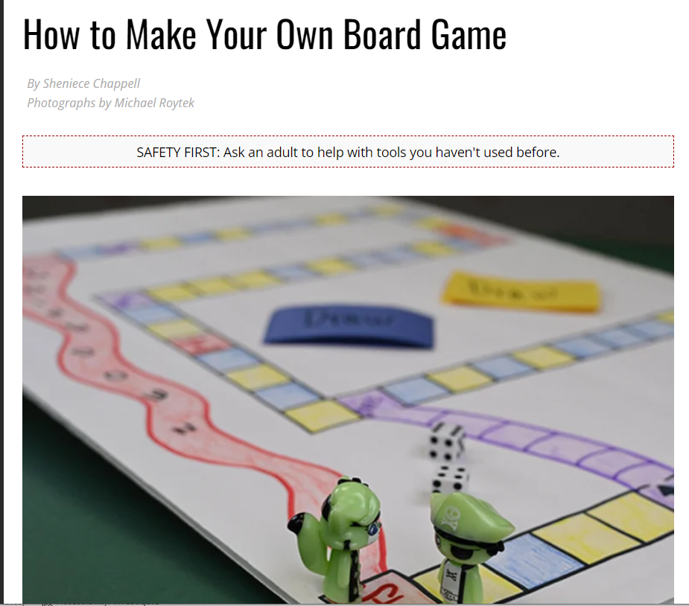
Workshop- Tips and tricks!
Discover more ideas and tips how to make a board game:
Read the article that contains detailed steps of board making:
https://scoutlife.org/hobbies-projects/projects/172763/how-to-make-your-own-board-game/
Watch the YouTube Videos in which board game making takes place:
Notes:
Videos credits: https://www.youtube.com/watch?v=mFIGohsRRYc
https://www.youtube.com/watch?v=k2EuDpt2p6c
https://www.youtube.com/watch?v=mFIGohsRRYc
13

Slide 14
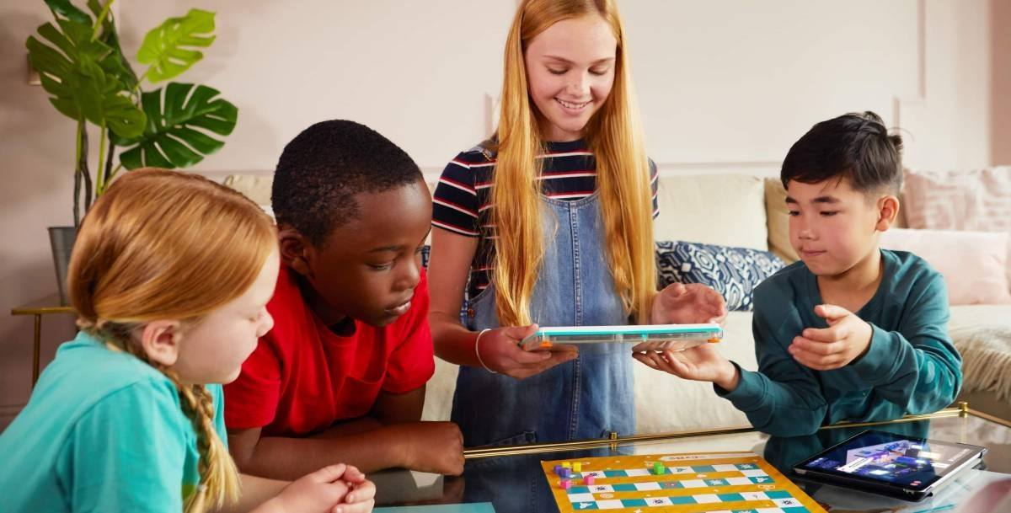
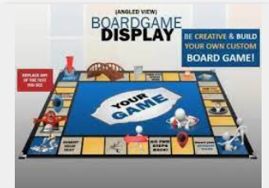
Workshop- Game time!
In groups, present your board game, show the board, game pieces, read the rules and instructions.
Choose a game that you like best and play it with your friend.
Try out as many games as possible.
Teacher records pupils while presenting or takes photos of the games.
Notes:
Photos credits: https://www.pinterest.com/pin/657877458046695305/
https://www.amatterofstyle.eu/inspire-me/benefits-playing-board-games
14

Slide 15
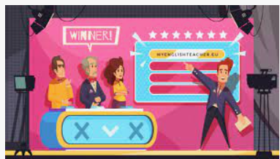
Alternative to a Board Game: Make Your Own Quizz
You are a quizz maker, and you have been assigned the task of creating an online quizz that will help students learn and review the book in a fun and interesting way!
Collect at least 25 questions and answers for your quizz that relate to the theme.
Follow the instructions carefully to make and share your quizz:
Notes:
Photo and video credit: https://www.youtube.com/watch?v=JRxLIdemLPw
15

Slide 16
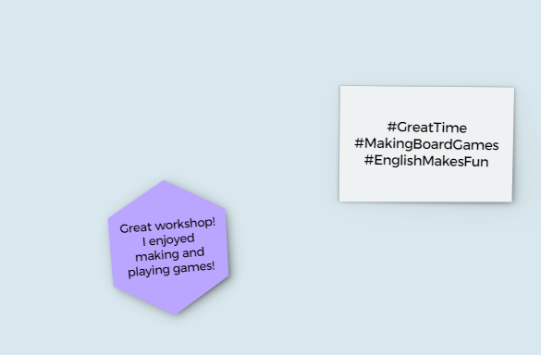
Post it!
Write Instagram Post or Facebook Status on your impression of the workshop on small, sticky pieces of paper and put it on the board.
Read other pupils’ posts.
How did they like the workshop?
Alternative:
Use online app and write/share your posts:
https://howto.ideaflip.com/en/articles/637712-how-to-work-with-notes-and-elements
Notes:
Photos credits: https://www.google.com/url?sa=i&url=https%3A%2F%2Fwww.uq.edu.au%2Fnews%2Farticle%2F2022%2F09%2Fstudy-finds-social-media-encourages-teen-substance-use&psig=AOvVaw2Q18uInJa3svCChH0QHUbX&ust=1664026577177000&source=images&cd=vfe&ved=0CA0QjhxqFwoTCND2n5qEq_oCFQAAAAAdAAAAABAn
16

Slide 17
Notes:
Photo credit: https://www.vecteezy.com/vector-art/1220888-the-world-belongs-to-those-who-read-quote
17

