Slide 2
WORKSHOP: All the world’s a stage
Read the quotation.
If there’s any unknown words, look it up here.
What does it mean?
Who wrote it?
What do you know about William Shakespeare?
If you want, click here and find more information about one of the most famous English writer of all times. ☺
Notes:
Photo credit: https://nosweatshakespeare.com/quotes/famous/all-the-worlds-a-stage/
2

Slide 3
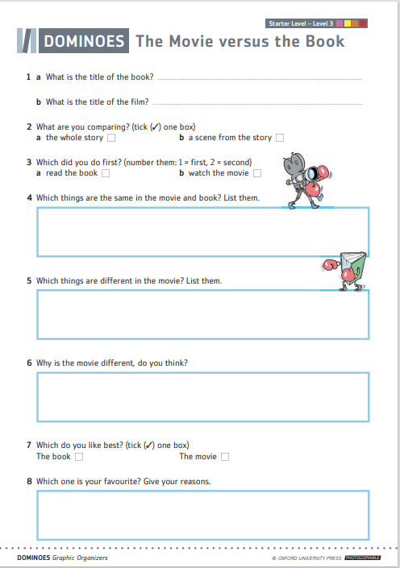
Introduction
In pairs or small groups discuss the following questions:
Have you ever watched a movie and read a book with the same title?
If yes, which one?
What did you like best, a book or a movie?
Why?
Complete the worksheet The Movie versus the Book individually and then talk about it in pairs or groups.
If you haven’t seen and read the same movie and book, think about possible differences and similarities.
Notes:
3

Slide 4
Introduction
Watch the trailers and try to find the matching e-books in ORC.
Hint! - The corresponding e-books are found in either Dominoes or Bookworms collection. ;)
Do you know anything about these movies or books?
What genres do they belong to? Why?
What are they about? Can you describe the main characters?
Who wrote the books? Do you know anything about the author/the director? Is he/she famous?
Notes:
Videos credits: https://www.youtube.com/watch?v=iKUzhzustok
https://www.youtube.com/watch?v=k2XNULhMC18
4

Slide 5
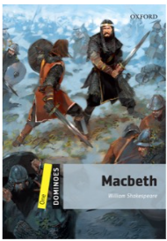
Introduction
Watch the trailers and try to find the matching e-book in ORC.
Hint! - The corresponding e-books are found in either Dominoes or Bookworms collection.☺
Do you know anything about these movies or books?
What genres do they belong to? Why?
What are they about? Can you describe the main characters?
Who wrote the books/directed the movies? Do you know anything about the author? Is he/she famous?
Notes:
Videos credits: https://www.youtube.com/watch?v=YqHhKuCQmoY
https://www.youtube.com/watch?v=NXc5epxOH_c
5

Slide 6
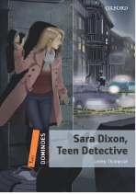
What can we discover by reading?
Quickly skim and scan Dominoes and Bookworms Collection and find at least five examples of e-books that belong to Mystery & Horror genre:
Compare your answers with other classmates.

Slide 7
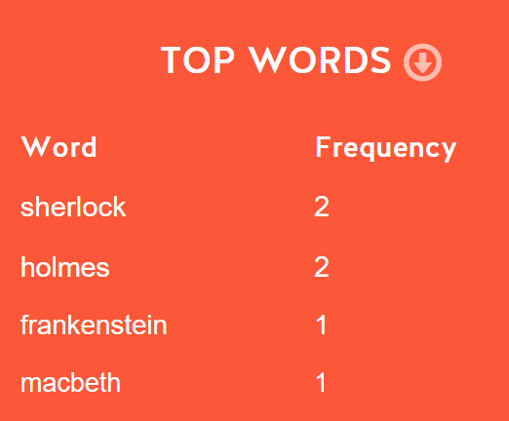
Read your way to better English! ☺
Form groups of 5-6 students and sit in a circle.
Choose 3 horror or mystery books that you would like to read and, on a piece of paper, write down the titles.
Collect the pieces of papers, read it out loud to find out which title is the most common.
Instead of writing on a piece of paper, you can write down words here and discover the most frequent one.
The name of which book appears most frequently? That’s the one your group will be reading. ☺
Notes:
Photo credit: https://www.dreamstime.com/overhead-shot-high-school-pupils-using-digital-tablets-group-study-around-tables-overhead-shot-high-school-pupils-using-image126999389
7

Slide 8
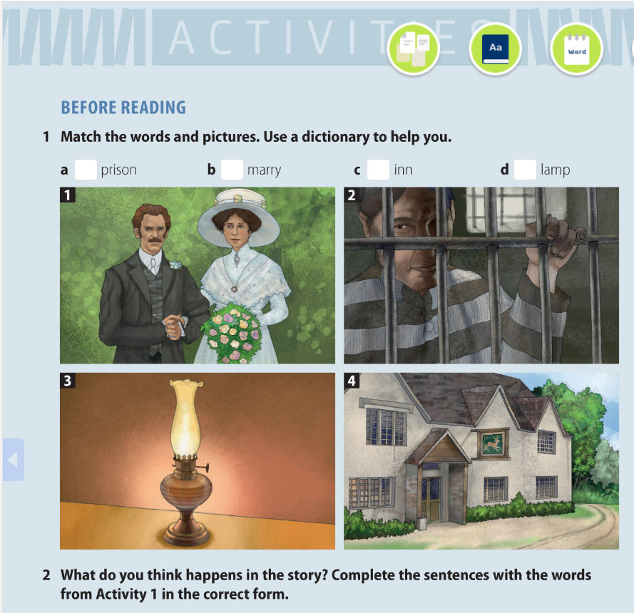
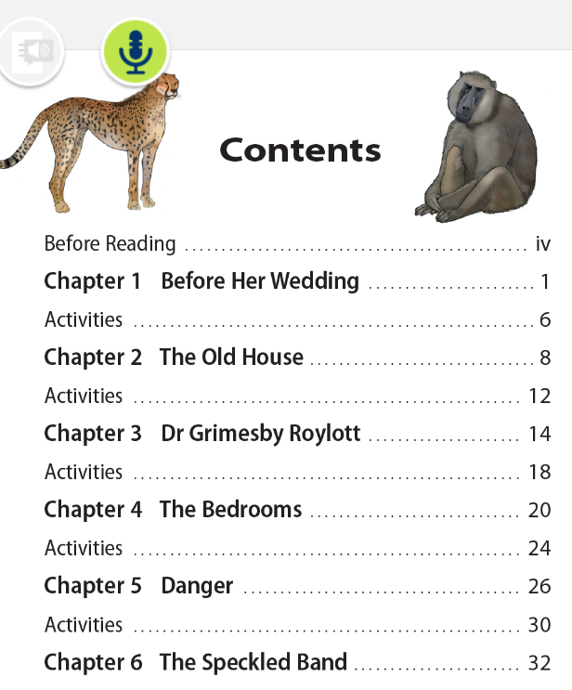
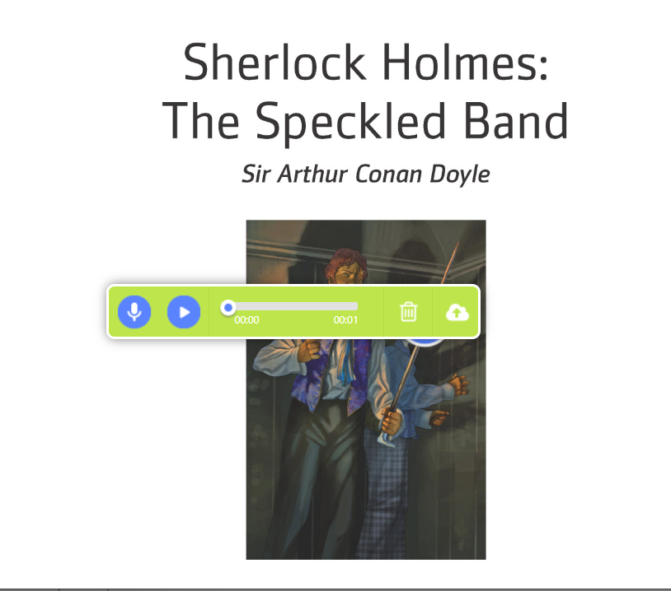
Pre-reading activities:
In your teams, do the „before reading”
activities (p.6). Check and comment your
answers.
Read the titles of all chapters and
predict in your team what is going to happen
in each one.
Record your team’s predictions.

Slide 9
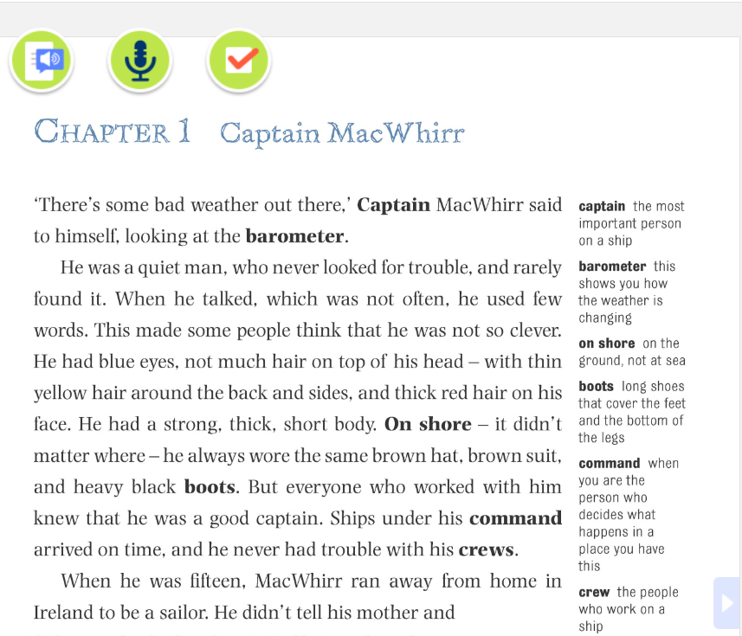
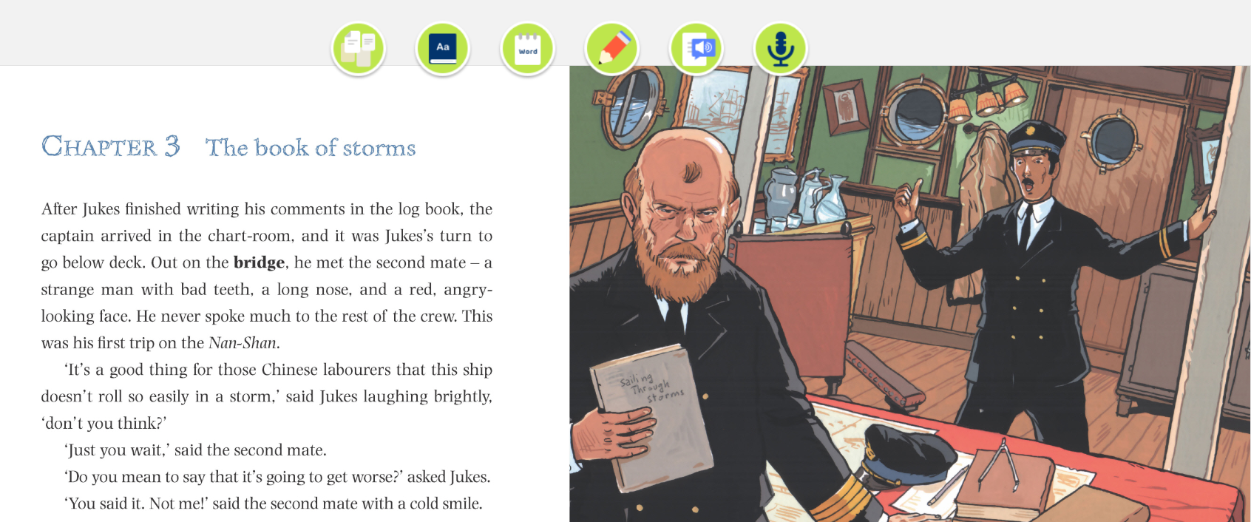
reading:
Read chapters 1-3 :
depending on your level, you can read one or more chapters
You can read and/or listen
Use earphones if necessary
Determine pace and dialect
Notes:
9

Slide 10
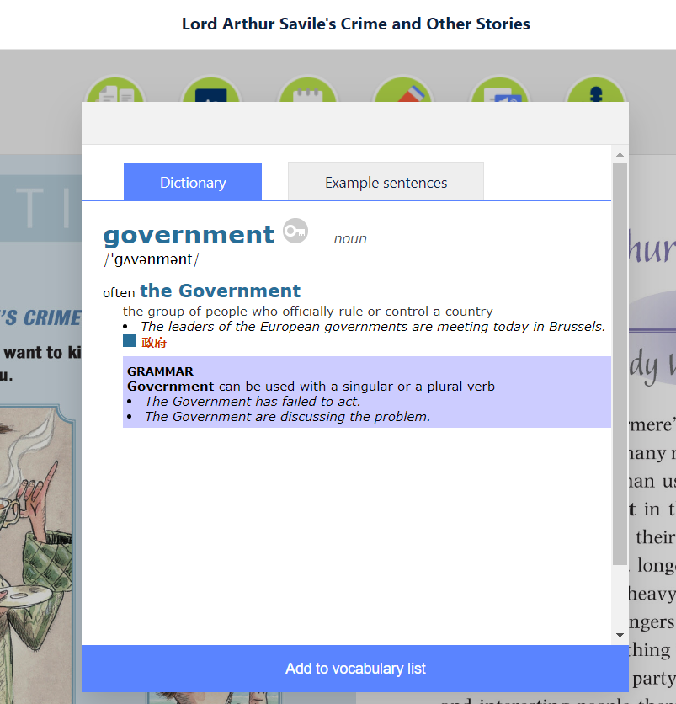
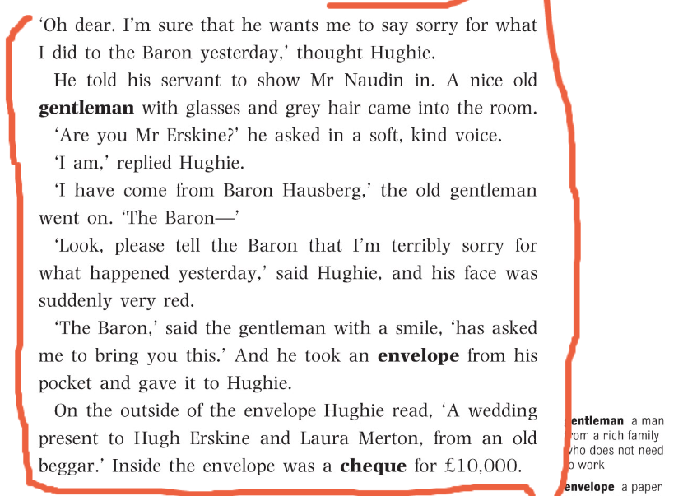
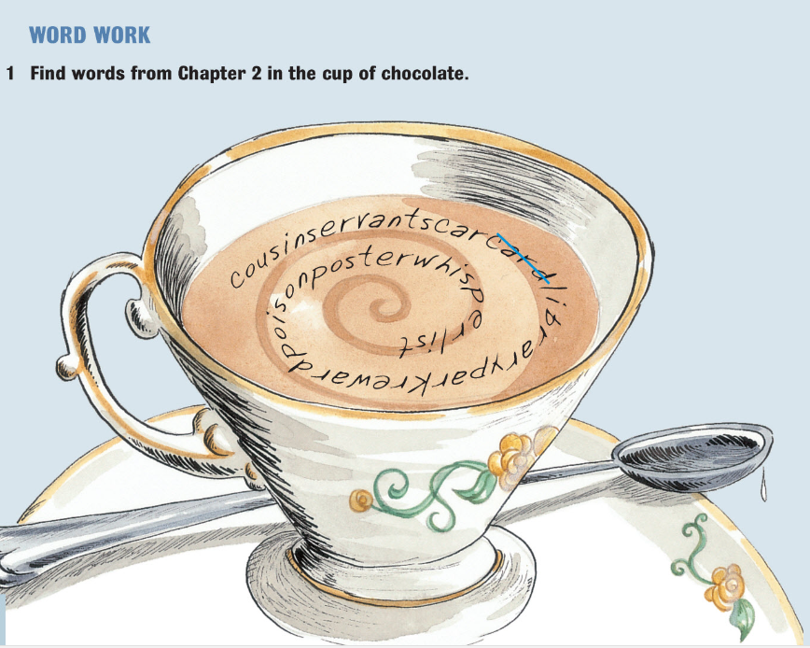
While-reading activities:
Find the meaning of any unknown
words (dictionary) and add them to your
Vocabulary list
Underline the most thrilling scenes or
descriptions
After each chapter, do the exercises
(reading comprehension, vocabulary and
prediction)
Compare and discuss the answers in
your Team.

Slide 11
After-reading activities:
In your team, play and comment the prediction notes from the beginning. What really happened?
Read the underlined scenes/descriptions and explain why you find them exciting.
Comment the unknown words by looking at your vocabulary list and asking your teammate:
„Do you know what does a word government mean? Do you want to hear an example sentence?(...)”
Notes:
Photo credit: https://www.schooloutfitters.com/blog/3-questions-to-ask-when-planning-your-21st-century-learning-environment
11

Slide 12
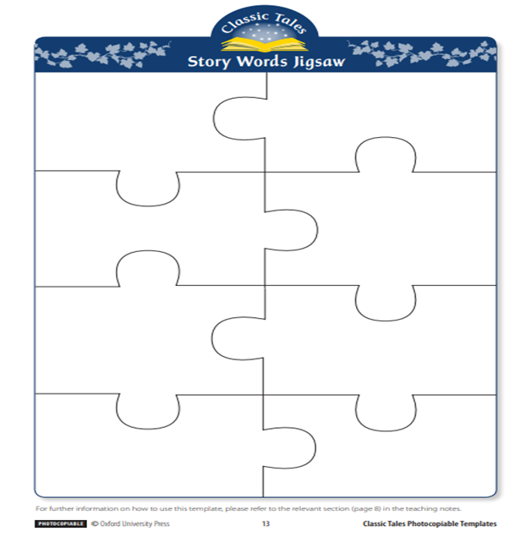
Make your own games!
In your teams make and play vocabulary/word games.
You can use the following free, online applications to create your word games or paper worksheet Story Words Jigsaw :
Puzzlemaker
Quizlet
Your task is to:
open the application
follow the instructions
use your Vocabulary List in ORC
create either Matching Game with timer (Quizlet) or
Criss Cross Puzzle (Education Puzzlemaker)
share the game with your teammate and try to solve it as quickly as possible. ☺
Try an example game:Match: Mystery &amp; Horror Vocabulary List | Quizlet

Slide 13
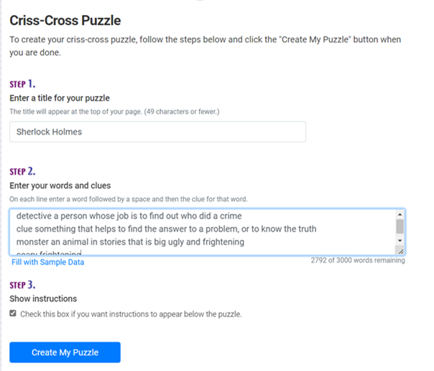
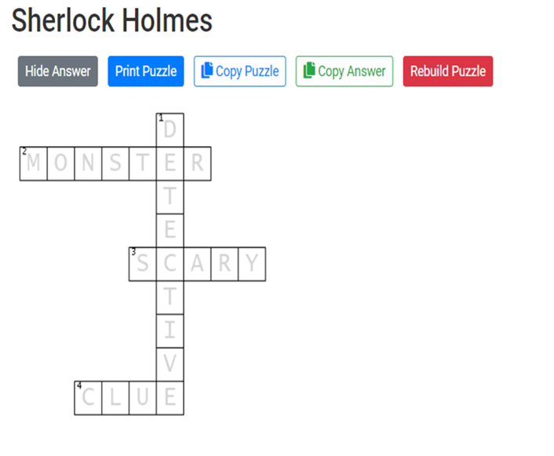
Puzzlemaker
Click here to open the app: Puzzlemaker
Follow the steps below to create your puzzle:
Write down the title of the puzzle (e.g. the name of your e-book)
Enter your words and clues (on each line write a word followed by a space and then the clue for word)
Click Create My Puzzle
Copy your link and send it to your teammate per Teams, e-mail or simply switch your computers/laptops

Slide 14
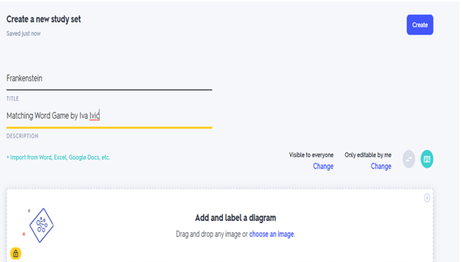
Quizlet
Click here to open the app: Quizlet
Follow the steps below to create your word game:
1) On the drop-down menu Create choose Study Set
2) Arrange general information about your game:
write a title (e.g. Title of a book)
write a description (e.g. Word Game by Iva Ivić)
and add an image (optional)

Slide 15
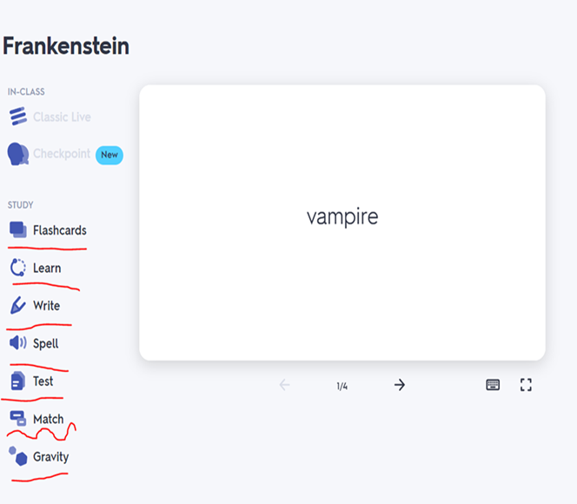
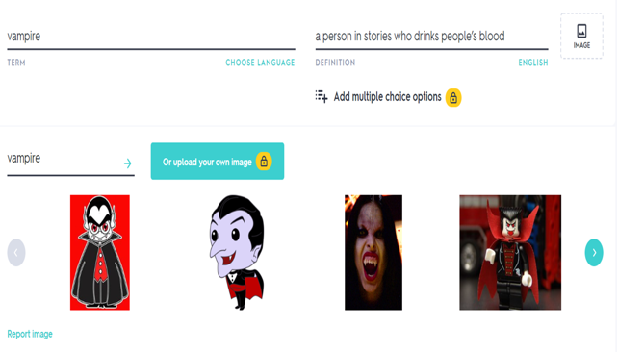
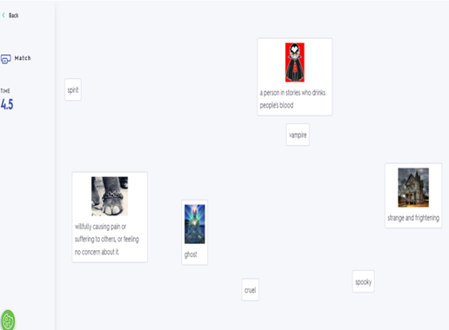
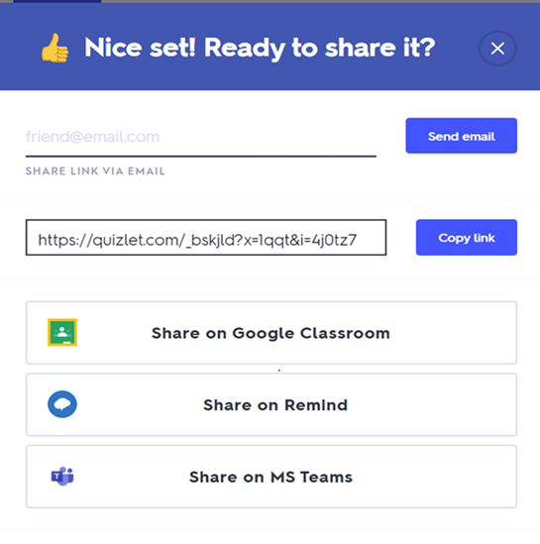
Quizlet
3) Create your game:
write down your words (* It’s important to choose language-English)
their definitions (use ORC Vocabulary/Dictionary)
add an image (optional)
add as many words as you want by clicking +ADD CART
Click CREATE to make the game
4) After you have created your word list, choose a type of game you want to play (Flashcards, Learn, Write, Spell, Test, Match or Gravity)
Try Match
5) Share with your teammate and play games
Explore a video on how to use Quizlet.

Slide 16
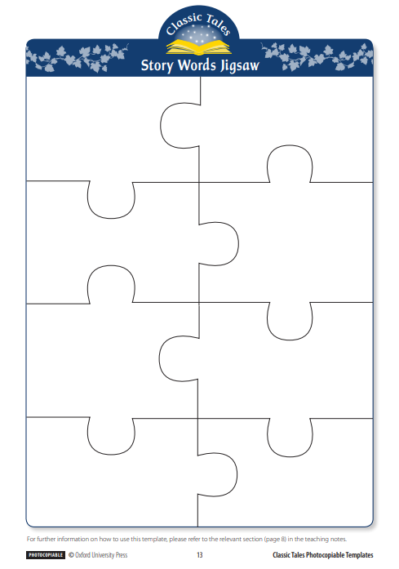
Paper Word Game: Story Words Jigsaw
Create your own Story Words Jigsaw with words and definitions from your Vocabulary List in ORC or any other words from the book that you find difficult or important.
You can use ORC’s Dictionary or write your own definitions. ☺
Cut up the jigsaw, mix up the pieces and give them to other teammates to put back together.

Slide 17
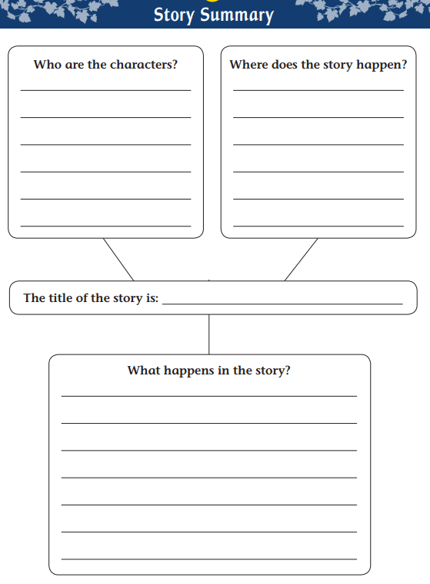
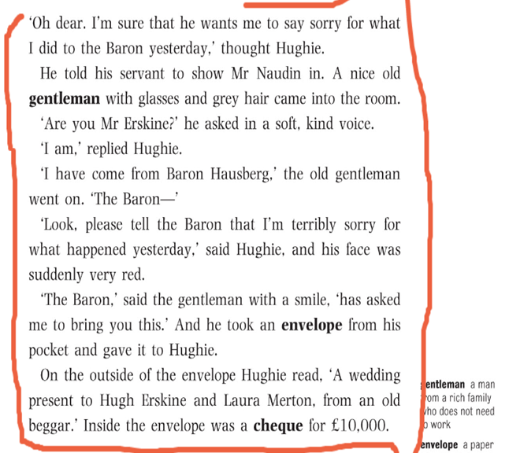
Finish your reader at home. Anywhere, anytime.
Your 4 tasks at home:
Make notes that will help you to complete the Story Summary sheet. You can write them down in the notebook or record and save them in ORC.
Underline the most revealing/thrilling dialogues
After you have read the entire e-book, it is important to complete the Story Summary worksheet
4) Last but not least- ENJOY your reading. ☺
Notes:
Photo credit: https://www.freepik.com/premium-photo/portrait-happy-middle-eastern-family-using-laptop-together-home-arabic-parents-their-cute-little-daughter-relaxing-with-computer-couch-living-room-watching-movies-enjoying-weekend_22279835.htm
17

Slide 18
Workshop time in your Teams!
In your Teams, Read and comment the Story Summaries
Read the most thrilling dialogues/scenes and explain why you chose them
Discuss in groups how to produce a short play and write down a list of steps that need to be taken:
Choose the story/scene(s)
Determine the character(s)
Decide on the setting
Outline the idea
Write your acts
Decide on the props ( e.g., Monopoly money for e.book One Thousand Dollars, a skull mask and a plastic sword for Hamlet, a black jacket and cucmber sandwichses for The Butler Did it...)
Notes:
Photo credit: https://www.istockphoto.com/photos/children-holding-hands-circle
18

Slide 19
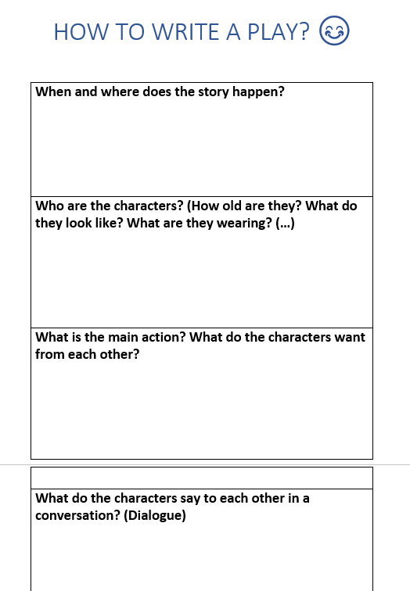
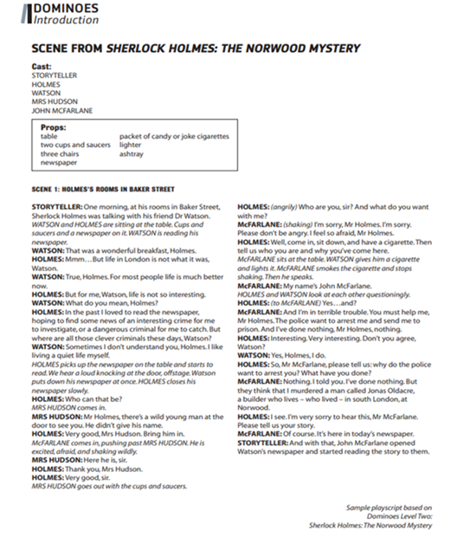
Workshop time in your Teams!
Examine worksheets (How to write a play? and/or Play Writing Template) and the example script based on a scene from Sherlock Holmes: The Norwood Mystery
Do you find the worksheet useful in making a play? Would you like to add anything to it from your previous notes?
How do you like the example script? Would you change anything?
Are you ready to produce your own play? ☺
Notes:
19

Slide 20
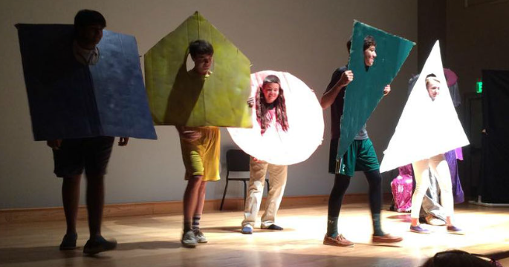
Workshop time! The classroom’s the stage ☺
Choose the scene(s) that your group will be interpreting
Organize the play making (use your written steps + worksheets)
Rehearse your scene(s) as many time as necessary
Act out the scene(s) in front of other groups
Record it and share it with other teams
Comment on other groups’ plays
Notes:
Photos credit: https://www.ecclesiaarts.com/acting
https://amhsnewspaper.com/3870/news/mrs-pirchs-drama-classes-perform-dramatic-plays/
20

Slide 21
Workshop time
As a group comment the following questions:
How did you feel working on the play in your group?
Did you speak softly and politely in the team?
Did you listen to each other?
Did you take turns in speaking/giving ideas etc?
Were you encouraging and supportive?
What are the things that went great?
What would you change for next time?(...)
Comment your impressions with other groups to see what went great and what could be changed for the next time. ☺
Notes:
Photo credit: https://unsplash.com/s/photos/kids-hugging
21

Slide 22
Notes:
Photo credit: https://www.dreamstime.com/motivation-lettering-quote-books-reading-world-belongs-to-who-read-colorful-design-book-cafe-stores-image179878631
22

